Slide 1
Elays Network
By the community, for the community.

Slide 2
Elays Health and Wellbeing
The Elays health and wellbeing department was developed for two main purposes:
1) In working with the youth, we recognised the importance and necessity of working with the family as a whole to create happier, healthier, more confident and well-adjusted children and young people, which in essence will create happier, healthier, more connected and well-adjusted families and members of society and by extension society.
2) A response to the health inequalities witnessed within our service users and local communities. Witnessing women suffer avoidable health complications, scares and near-death experiences during pregnancies and births. Poor management and support for those with health conditions (inc. mental health conditions) and chronic illnesses and poor diagnostic timings.

Slide 3
Wellness with Elays
With a lack of accessible and affordable physical activity spaces that they can feel comfortable in, we consulted our service users and local community and designed wellness with Elays. A women only holistic wellness project that started in June 2021. The aim of the project was to address their needs and empower them through improving their physical health, mental health and provide an educational space that will strengthen them in taking control of their health in a confident manner.

Slide 4
Wellness with Elays
In November 2021 we started an incredible partnership with LKY and Dami from Public Health Wandsworth in supporting and facilitating the project.
Meet every Tuesday and Friday 11am for yoga and strength training session.
Fortnightly discussion on various topics such as self care, mental health, creating healthier connections.

Slide 5
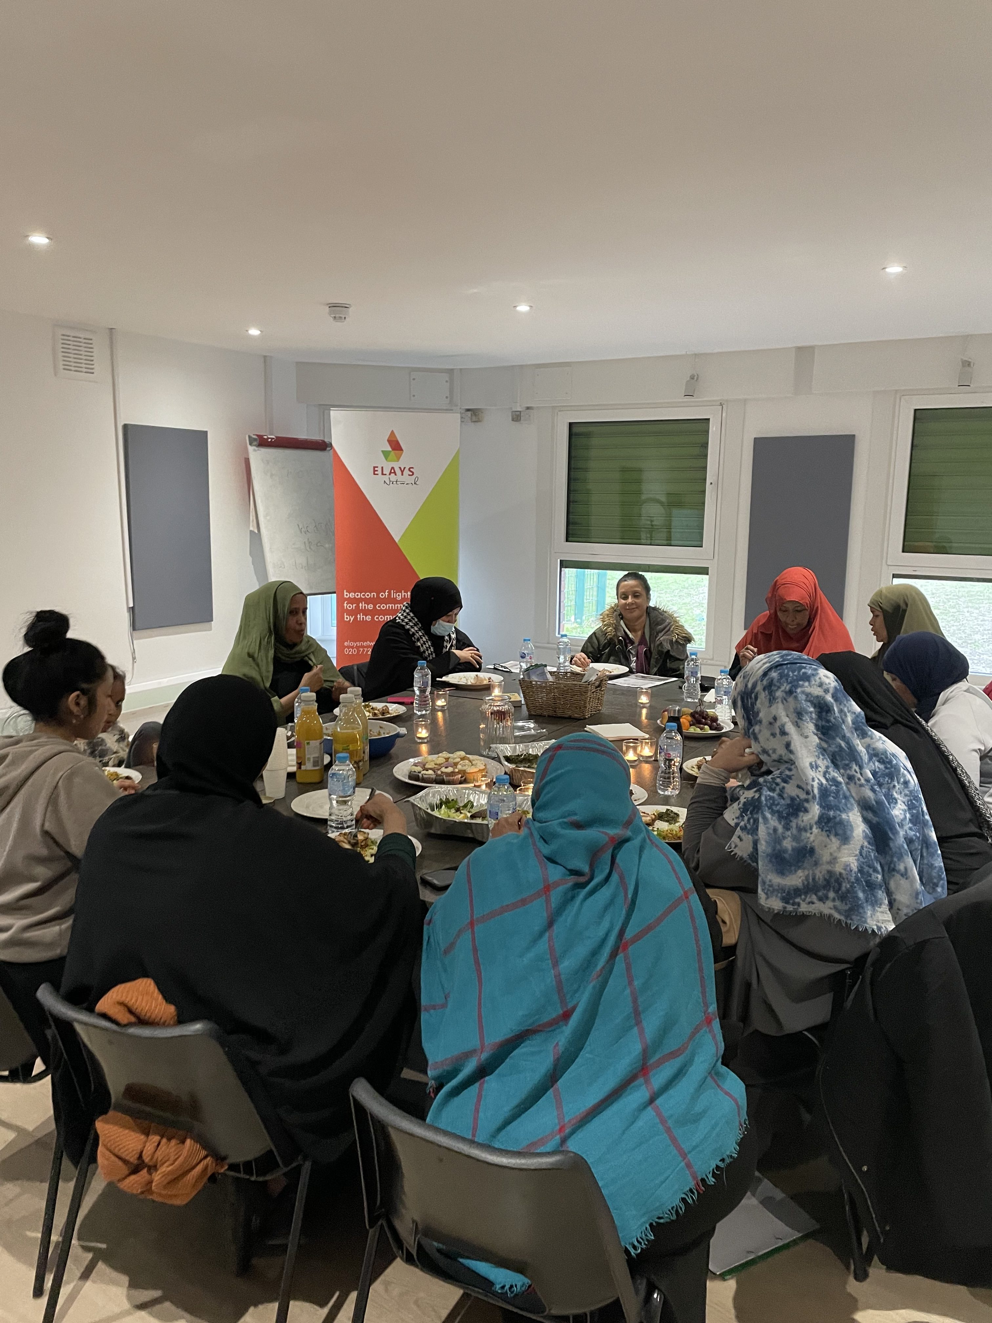
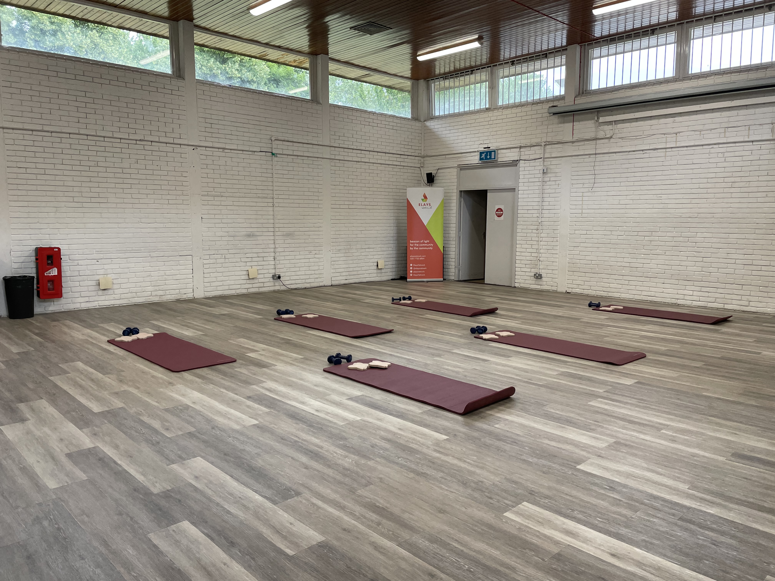
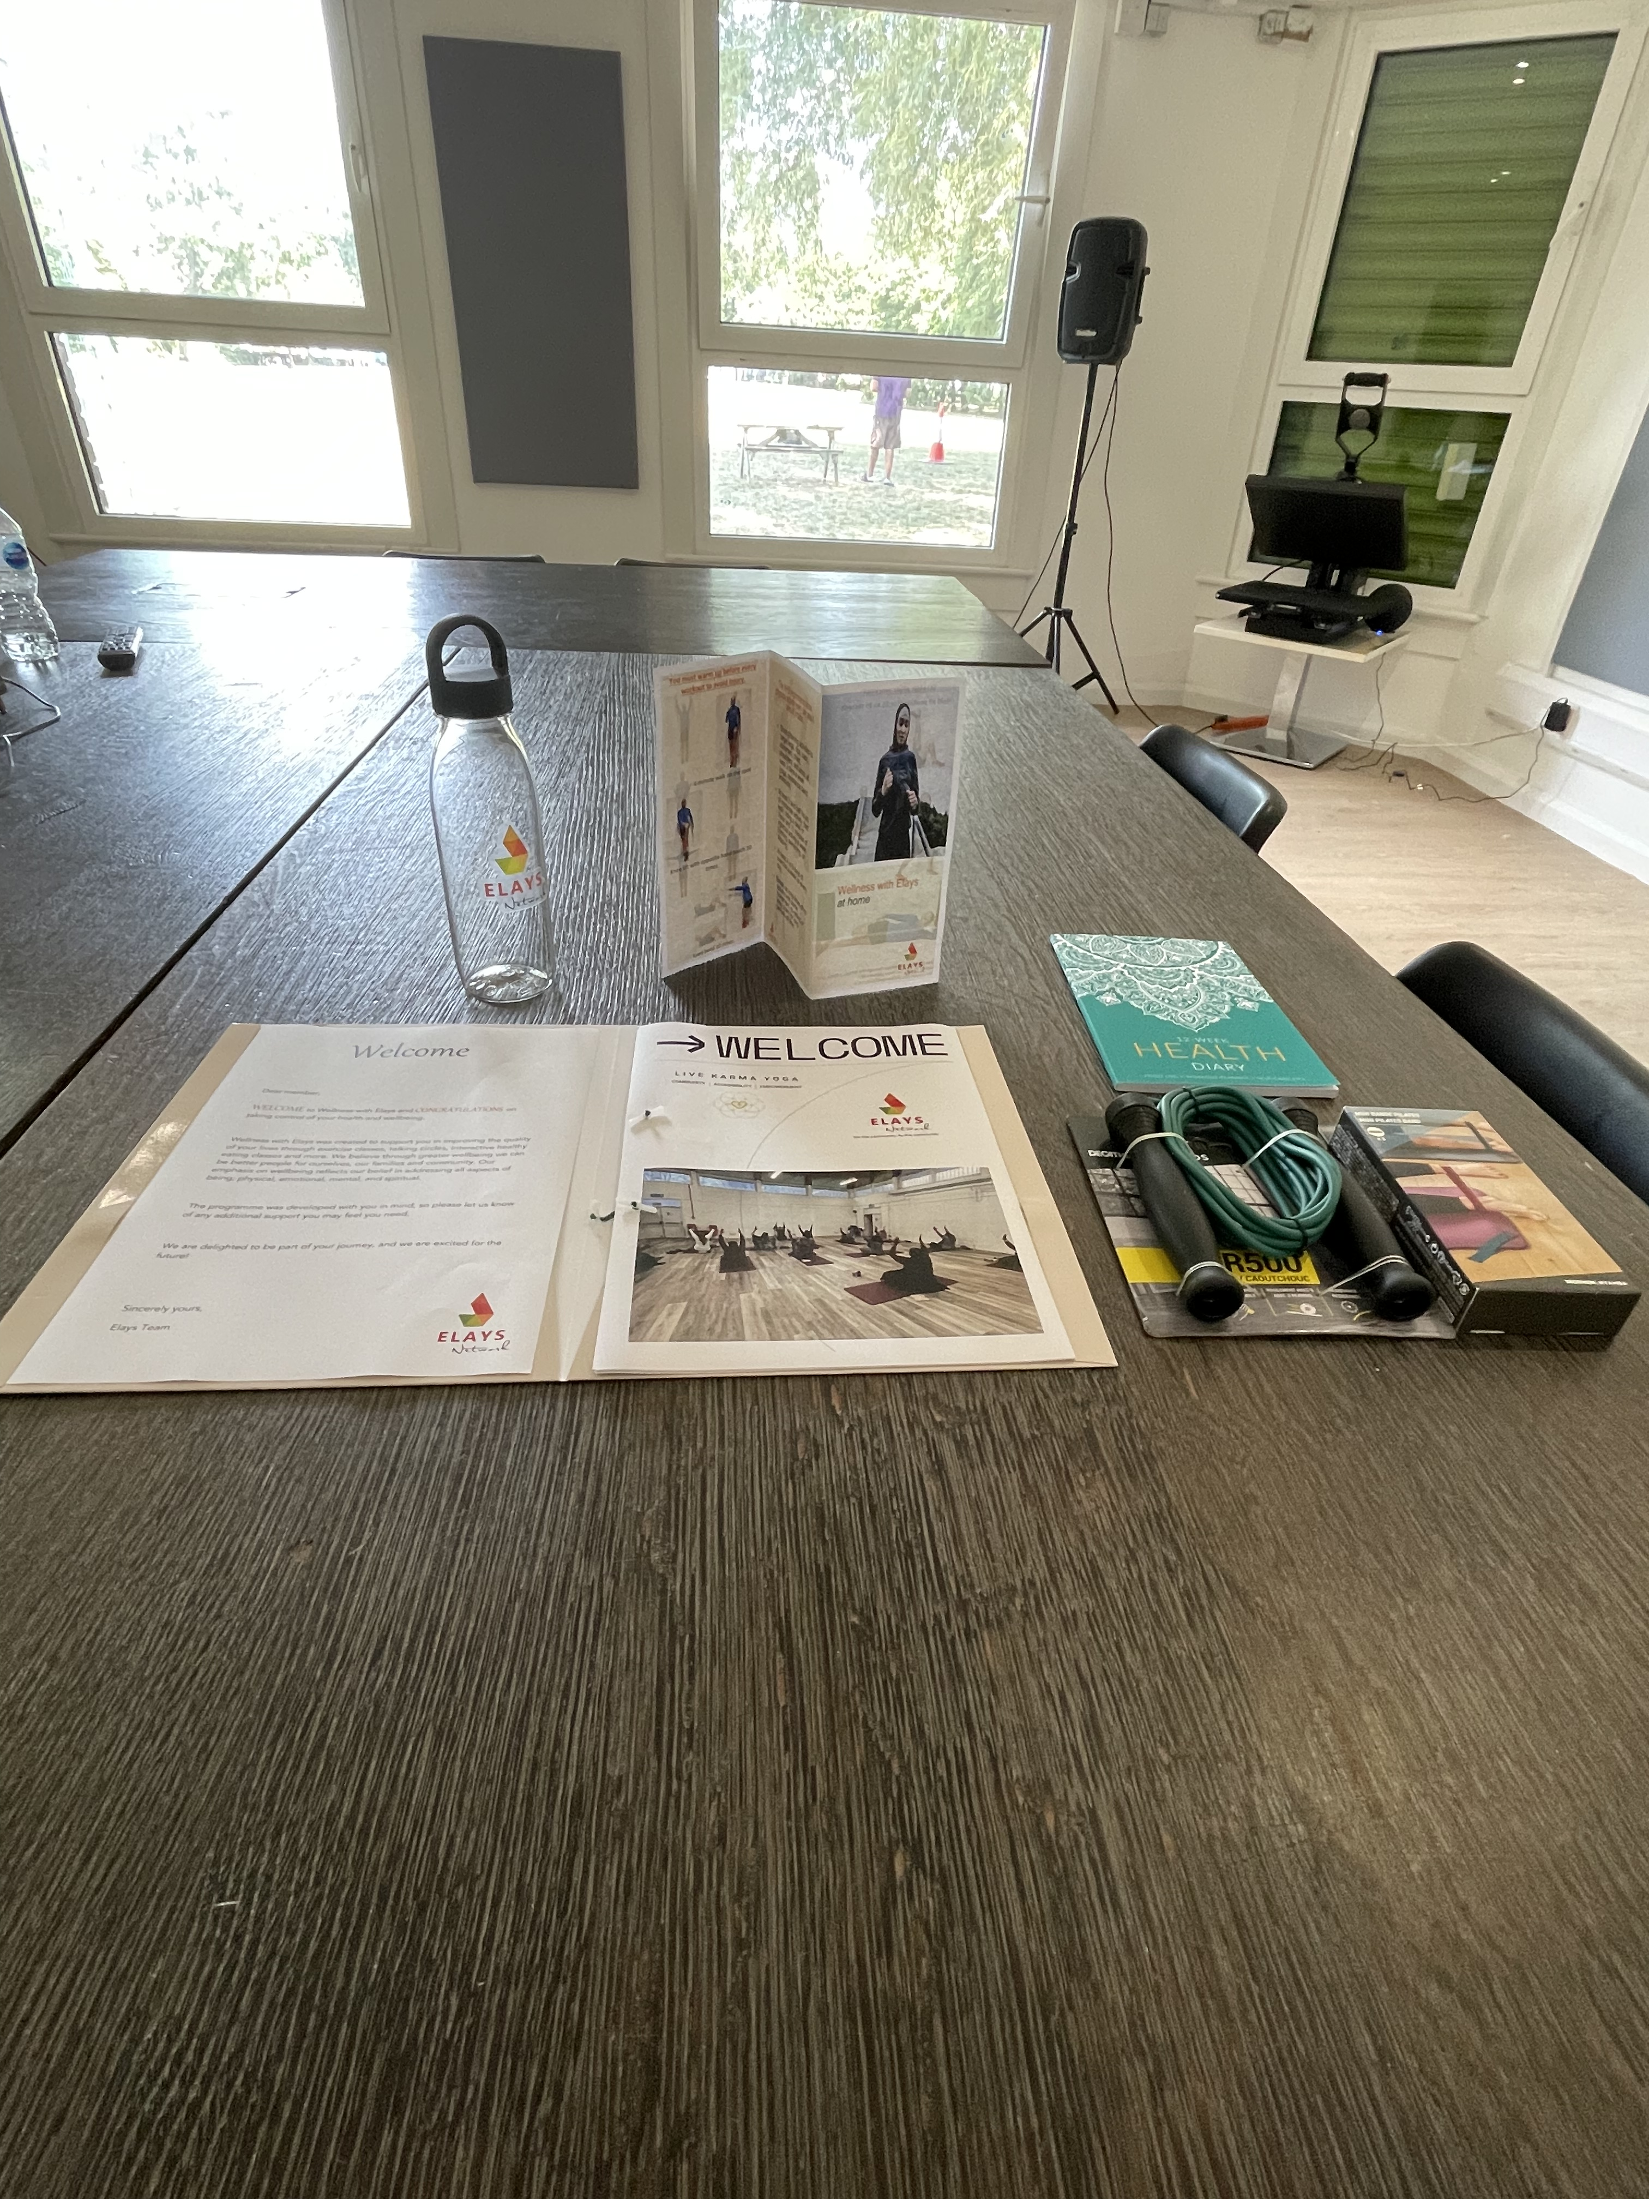
Feedback
“ I used to struggle with any physical activity, and I found the most basic things difficult. Now, because of the sessions and kit you have given us, I jump rope at home and my kids laughed at the beginning but now they join me. We are starting a new chapter, my kids seeing me allows them to engage positively with physical activity. ” Ifrah Ahmed
“After our discussions, especially on self-care and mental health, I see so many of my friends struggling, they are always worried, and I know the fact that they do not take care of themselves too is making their mental health worse. These conversations helped me understand so much about myself and our communities” Anonymous

