Slide 1
Working together with the Wandsworth Community
Mark Creelman, Locality Director Merton and Wandsworth
South West London Clinical Commissioning Group
Naomi Good, Patient Engagement Manager
NHS Wandsworth South West London Clinical Commissioning Group `

Slide 2
What we will talk about
Introduction
History of PPI in Wandsworth
How we engage
PPI during Covid-19
Capturing the lessons learned from the pandemic
Transition - Integrated Care System
Looking Ahead - Progressing PPI in Wandsworth

Slide 3
1. Introduction
Patients are at the heart of everything we do to improve the health of people in Wandsworth
Decisions are made based on the feedback of patient experiences we receive and gather and the involvement of local people at all levels including;
planning, procuring, service improvement, integrated care pathway design, governance, evaluating and monitoring.
Our engagement approach is ever evolving.

Slide 4
2. History of PPI in Wandsworth
PPI has a long history in Wandsworth
It is central to the values and principles of the NHS
The structures have evolved over time

Slide 5
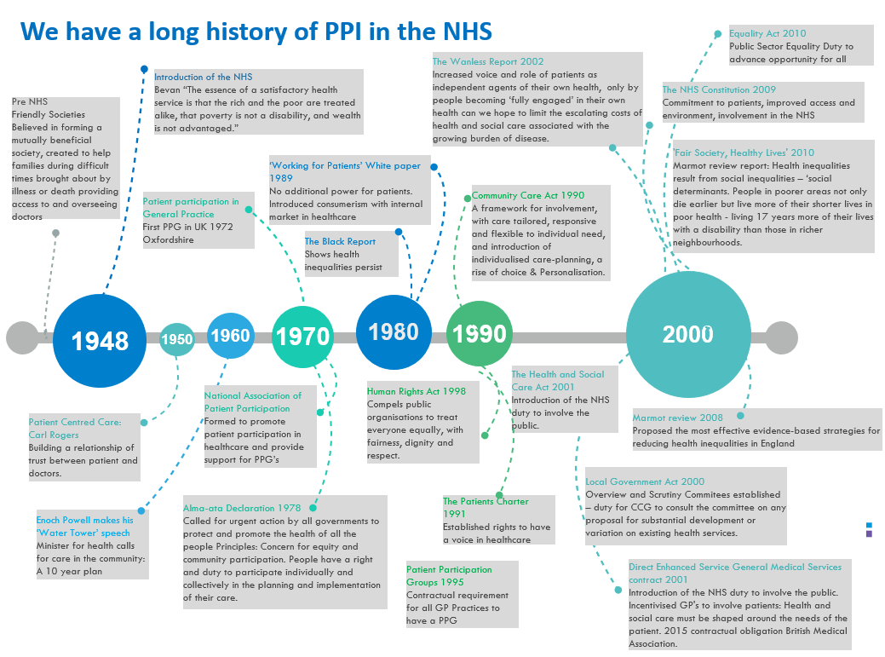

Slide 6
Wandsworth CCG formed
2012
We have a long history of working with patients, public and clinicians to develop and improve pathways in Wandsworth
The Health and Social Care Act 2012
Duty to involve patients and the public Section 242
2013
Expert Patient Programme
PPI Reference Group Autumn 2012
Thinking Partners Assures the CCG on equalities
Lay Representative on Board
Community Grants
EDAY Equality Delivery Action Yes embedding Equality and Diversity in Commissioning
2014
Members Development Programme PPI workshops in GP practices
Productive PPI (NHS 70 award winner) Patient voice in GP practices
2015
PPI on Clinical Reference Groups
Seldom heard communities GP visits
2016
Community Adult Health Services Patient Experience Group 2015
Wandsworth Health Involvement Zone
2017
Learning lunches
Youth Health Jury
Young Commissioners
Men’s Health Forum
2020
2018
2019
Trailblazer
BAME Forum
Barriers to accessing healthcare

Slide 7
3. How we engage – our family tree
2015-2020

Slide 8
3.1 How we engage

Slide 9
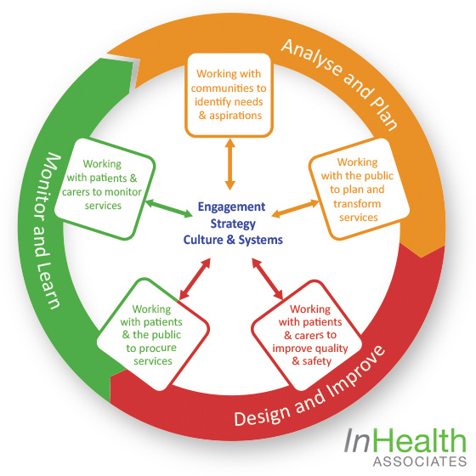
3.2 How we engage - Engagement Cycle
We aim to use this cycle to adopt an integrated approach to Patient and Public Involvement and engagement.
This supports people involved in transforming care pathways to involve effectively by aligning engagement activity with the stages of the commissioning cycle itself and from the start.
Involvement in:
Determining health needs and priorities
Assuring engagement plans and reporting processes
Service improvement and transformation
e.g. new service / pathway design
Procurement – reviewing and grading bids, interviewing prospective providers
Service mobilisation -new service visits, provider experience groups
Reviewing provider policies, processes and delivery

Slide 10
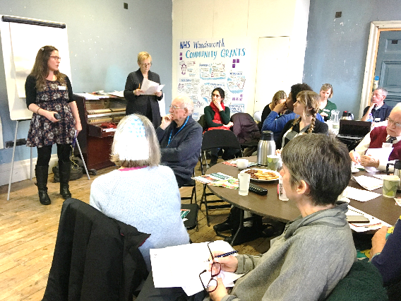
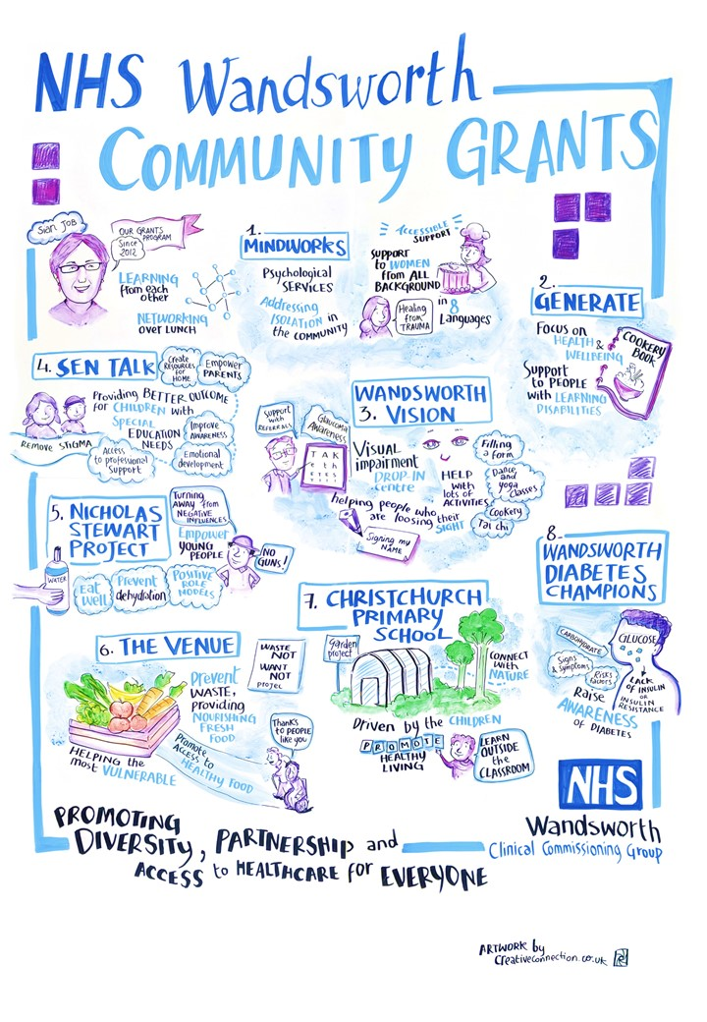
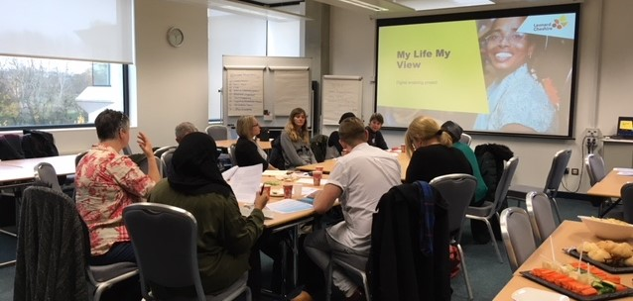
3.3 How we engage – Community Grants

Slide 11
4. PPI during Covid-19:how we have adapted our approach? Adapting to the virtual world
We explored online platforms – this has been an iterative process (Slack, Teams)
Sharing resources and messaging between meetings
Supporting our existing PPI members to get online – lots of 1:1 telephone support calls!
Creating clear guidance
Tutorials to use the platforms
Extra time to dial-in to meetings earlier than the start-time to address any issues and technological difficulties
Opportunities to continually feedback about the adapted virtual engagement.
We increased the frequency of online meetings
Both frequency of contact and the levels of attendance increased
Analytics pre and post Covid-19 show patient involvement meetings doubled in attendance (24 people joined our first patient group meeting during Covid-19 with a total of 43 people joining online, who were able to view and post messages).
In a single day, 109 posted messages were shared – timely messaging on mutual aid, emergency funding, changes in access to the NHS etc
Pooling together intelligence sharing across community organisations
Reduced barriers – travel, mobility, convenience, time

Slide 12
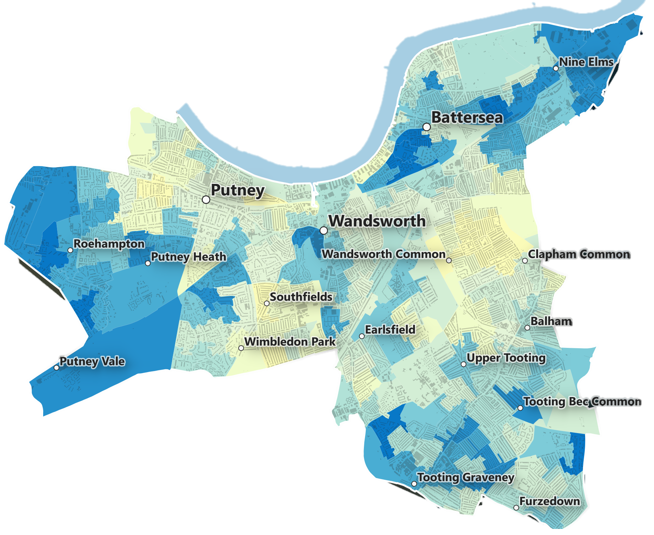
4.1 Covid-19: how we have adapted our approach? Areas and populations of interest
Wandsworth has an estimated 328,828 residents, the second highest in inner London, and a growing population. Nearly half of all people living in Wandsworth are aged between 25 and 44 years old.
There are significant social inequalities affecting young people and the elderly. 36% of children are living in poverty when housing costs are accounted for.
2016 research highlighted that a quarter of people over 60 were experiencing income deprivation.
Populations of interest | Communities in areas of deprivation Communities with Caribbean, Indian, Pakistani, and Somali backgrounds
Focus wards /Postcodes | Roehampton and Putney Heath, Southfields, Graveney, Latchmere, Queenstown Tooting – SW17 0 Latchmere – SW11 2 Queenstown - SW8 Roehampton - SW15 4 Furzedown - SW16 1 Doddington and Rollo - SW11 5 and SW11 4 Shaftsbury – SW11 1 Bedford – SW12 9
Source: English Indices of Deprivation https://imd2019.group.shef.ac.uk/ last accessed 10/09/2020

Slide 13
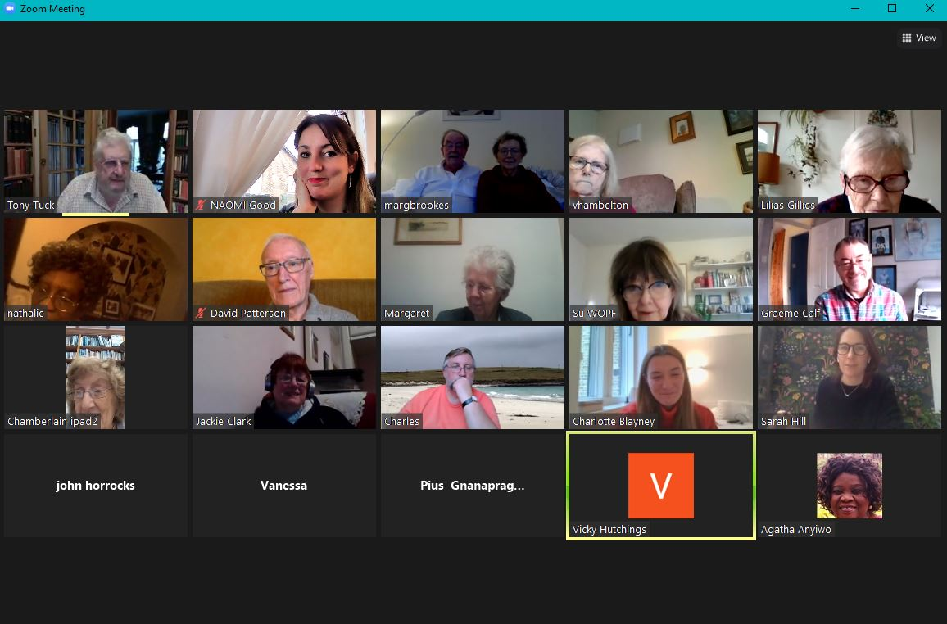
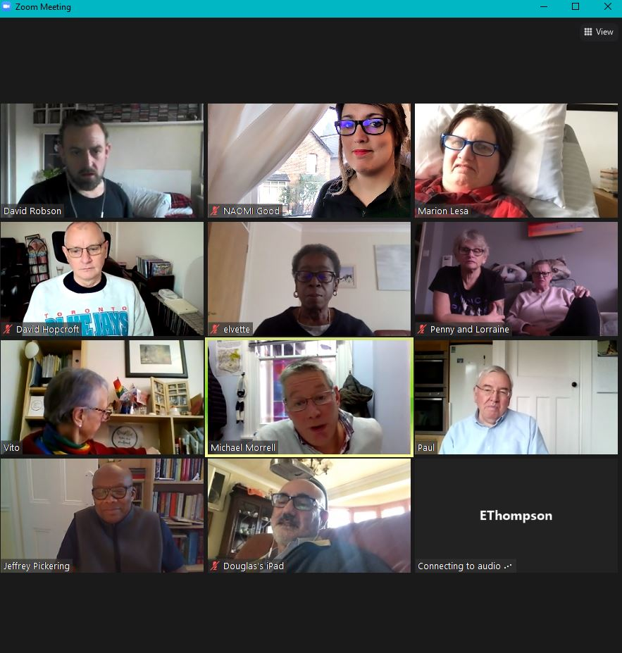
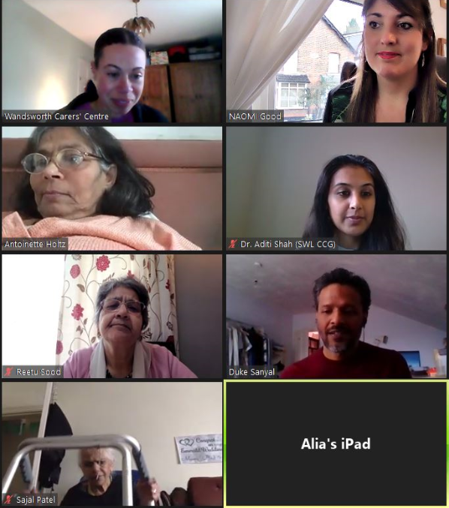
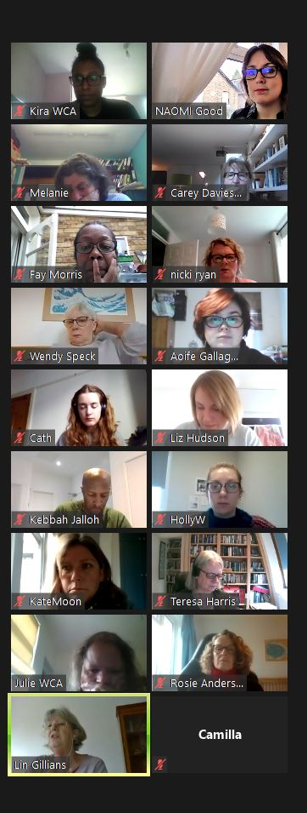
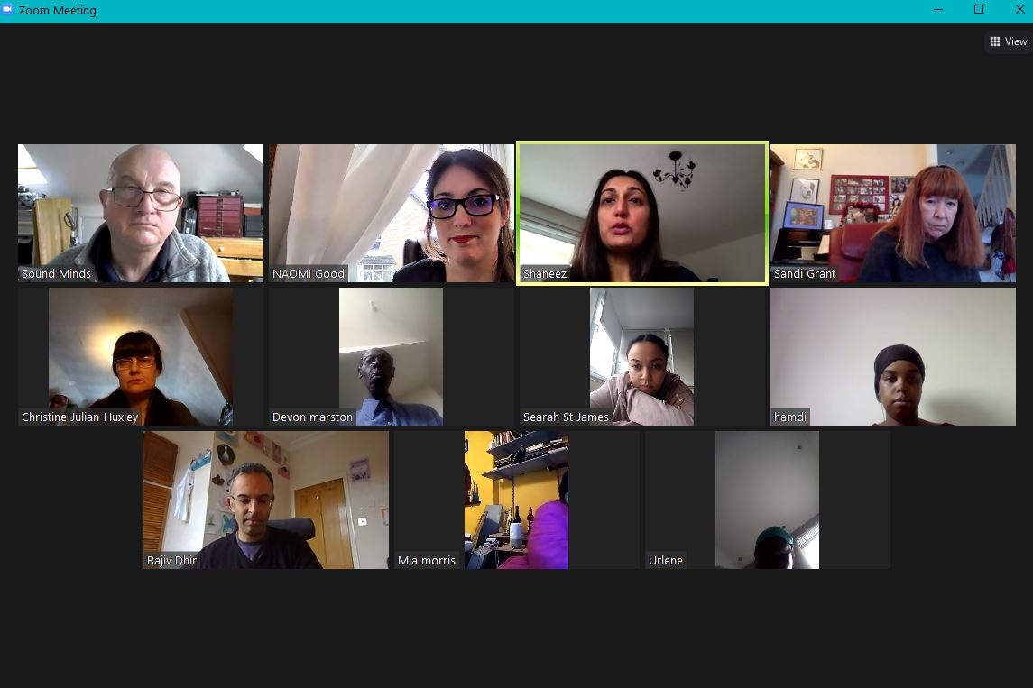
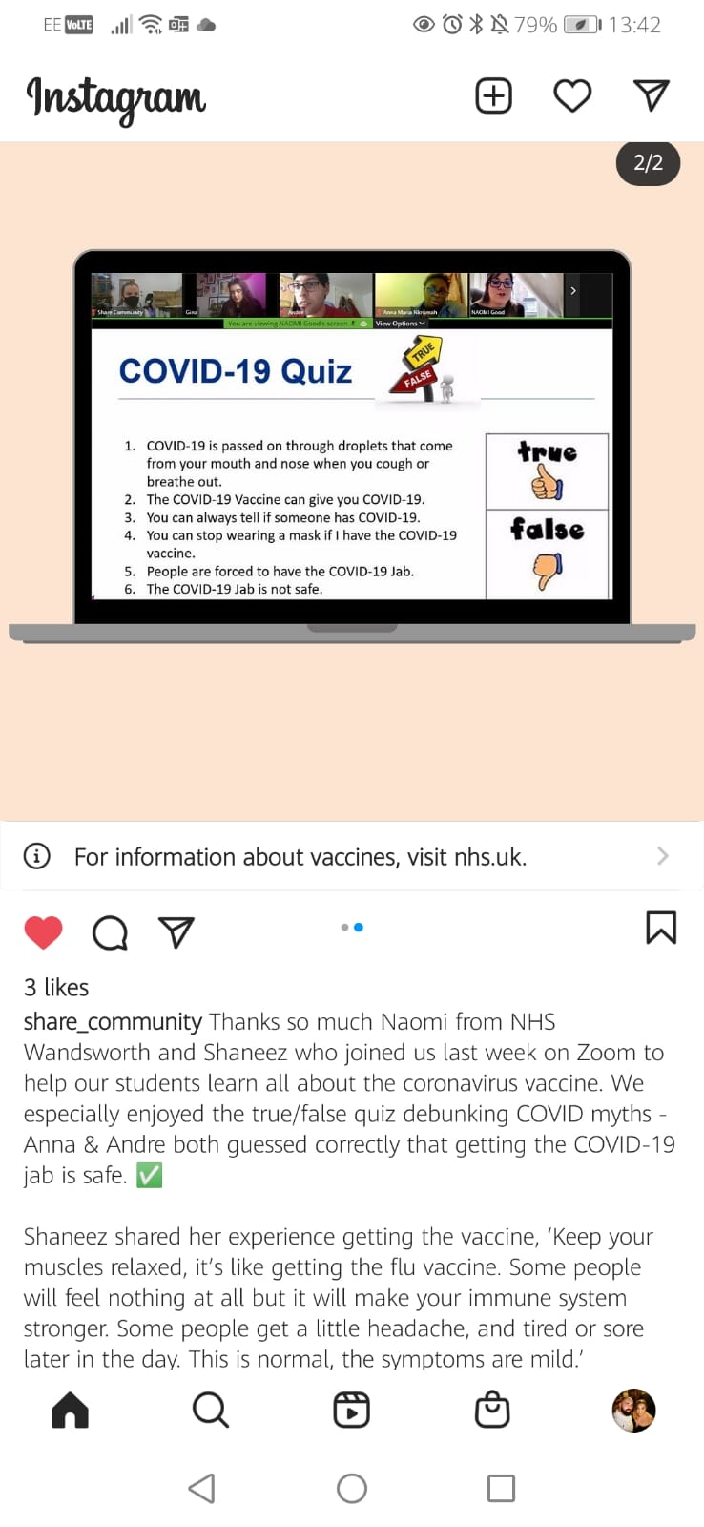
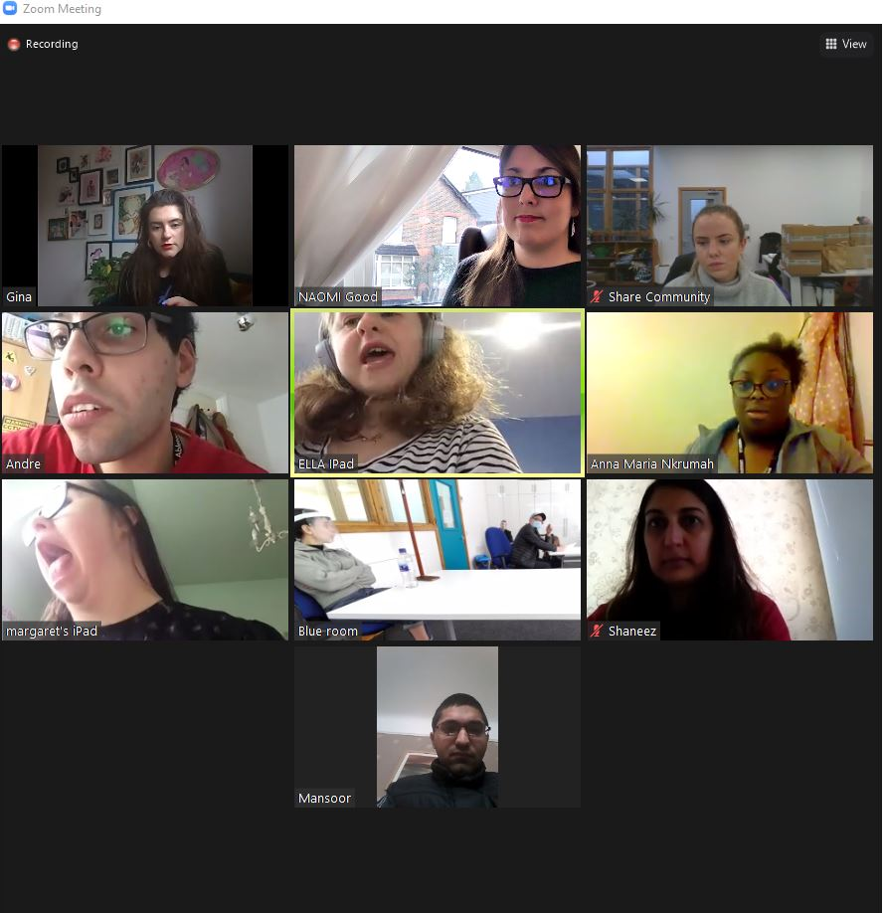
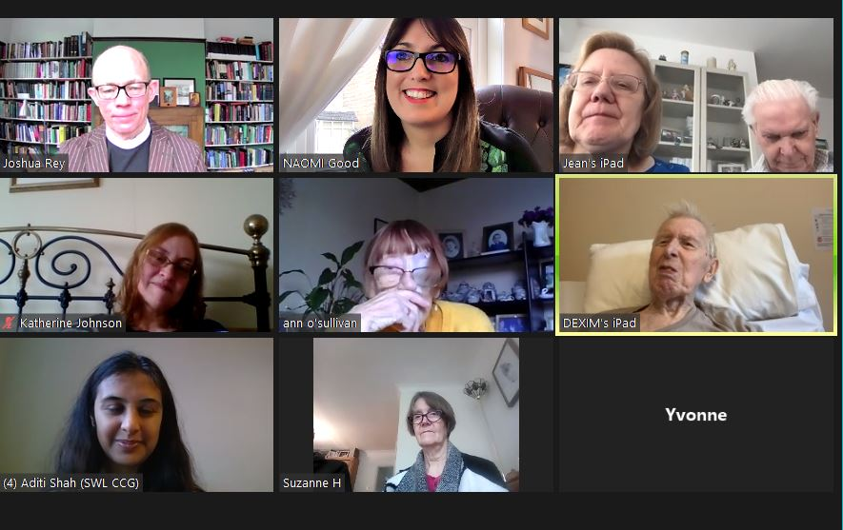
4.2 Covid-19: vaccine engagement
To date, we have worked with community groups to deliver 51 online Covid-19 vaccine information sessions
We have spoken with over 1900 attendees from diverse communities in Wandsworth.

Slide 14
4.1 PPI during Covid-19:how we have adapted our approach?
Addressing Digital Exclusion
Intensive 1:1 support to get online
Tech troubleshooting
Instructions created in multiple formats, using shared terms (windows were boxes etc)
Telephone conferencing
Creating a free dial in number
1:1 contact for those unable to join at first
Worked with community orgs like Age UK to send out important messages to peoples homes doorstep welfare checks
Funding applications to support those most excluded to take part (Learning Disability / Autism / Special Educational needs)
Wandsworth Community Grants

Slide 15
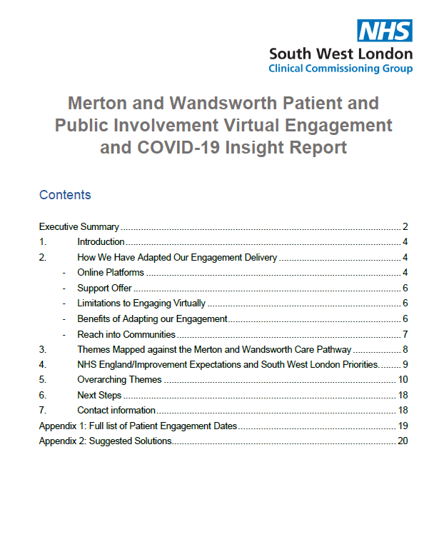
Capturing the lessons learned 5. 5.Capturing the lessons learned from the pandemic
Benefits and challenges of virtual engagement – digital inclusion / exclusion.
PPI stakeholder updates.
Cocreation of workshop content based on community interests.
Interactivity – quizzes, health education, Q and A’s, creative approaches.
Regular use of interpreters – best ways to facilitate multi-lingual engagement.
Increased engagement in partnership with clinicians – impacts include rapid codesign.
Data informed approaches.
Inter-generational approach to tackle digital exclusion and language barriers
Increased working with key local connectors with ‘ear to the ground’ for rapid response to any emerging concerns.
Peer health advocate models.

Slide 16
On 26 November 2020, NHSE/I published Integrating care Next steps to building strong and effective integrated care systems across England to open up a discussion with the NHS and its partners about how ICSs could be embedded in legislation or guidance. Feedback from the NHS and its partners on the discussion document was used to write a White Paper which was published on 11 February 2021.
6. SWL ICS Transition - Background

Slide 17
Capturing the lessons learned 5. 7. Looking Ahead: Progressing PPI in Wandsworth
PPI is ever evolving and will continue to grow and strengthen the Integrated Care System.
The strength of our relationships in the borough is integral to how we move forward and we will continue to work closely with Healthwatch to amplify the patient voice and ensure it is at the heart of NHS transformation.

