Slide 1




Healthwatch Assembly
Accessing healthcare –
changes and how to manage your health

Slide 2
Reminders:
We will be taking photos – let us know if you
don’t want to appear in photographs
Please save your questions and ask them to the relevant representatives at their stall
Presentations and resources will be available after the event on our website. Please feel free to share these with others
Contact us afterwards if you want to share something with us following the event.
If you need any assistance or support during the event, feel free to approach one of our staff members

Slide 3
Healthwatch Wandsworth
Health and Social Care Act 2012 established Healthwatch in English local authority areas and Healthwatch England to bring us together.
Independent champion for people using health and social care in Wandsworth.
Through community outreach and interviews we listen to peoples’ experiences of services and offer insight about their real experiences and what they want and need to the people who can make changes.
Working with health and social care services to
improve health and social care.
Events, newsletters, website keep
people informed and participating.
Sign up as a Healthwatch member to hear more!

Slide 4
Assembly Focus - Accessing healthcare
Questions and queries around accessing healthcare are frequent in enquires we receive at Healthwatch Wandsworth
Difficulties and issues with primary care have also been raised by residents over the past year
As a result, one of our projects for 2024/2025 has been focused on understanding how to improves access to GP services
Today we will reflect on some of our project’s emerging findings
This will be combined with an opportunity to speak to organisations who are working to address issues around access to healthcare

Slide 5
Emerging findings
General Access
  Difficulty of differences between how practices operate leads to confusion, inability to give general advice
  Move towards same set hours online forms are open to fill in
  GPs working towards call back functionality
  Majority of people still prefer to phone up to get an appointment – messaging needs to be clear that this ends up in the same process as utilising other routes
  Mismatch between availability of appointments in patients’ eyes and service providers’ eyes – better messaging around triaging and the process to get an appointment
  Changes to how you access primary care, not always an appointment with a GP- specialists utilised

Slide 6
Emerging findings
NHS App/Digital Access
  People are becoming more familiar with using the App and how to use online GP forms
  Still concern for those who struggle with/don’t have access to technology - practices should assure patients that they can support those who can't do the form themselves
  Still 8am rush just now online, however some practices moving towards morning and afternoon slots
  Loss of human touch raised as an issue
  Importance of the sensitivity of information delivered digitally

Slide 7
Emerging findings
Continuity of care
  Triaging has to prioritise processing people within 2 week timeframe
  Continuity of care is important for long term or complex cases, GPs have acknowledged that
  High turnover of support staff in surgeries can lead to lack of relationship building with complex individuals – flags need to be clearly displayed on these individuals records
  F2f versus online appointments - practices told us that patients can request f2f if they want, not all patients knew this
  Potentially use video calls rather than phone appointments

Slide 8
Emerging findings
Patient Involvement
  Real range of patient involvement across practices, some have well established groups others don’t
  Some practice managers have told us they want more engagement but hard for people to find time for it

Slide 9
New GP Contract for 25/26
National GP representative body the GPC has agreed this with NHS
New enhanced service for practices for advice and guidance, enabling specialist advice and guidance from secondary care for practices
Emphasis on an equitable experience regardless of access mode i.e phone, online, walk in
1st October all practices required to keep online form open for duration of core hours for non-urgent appointment requests, medication queries and admin requests 8am-6.30pm
By 1st of October GPs will have to accept Pharmacy First consultation summaries into their system
NHS England to publish a patient charter which will set out the standards a patient can expect from their practice. The charter will need to be published on the practice website – Healthwatch England involved in this process

Slide 10


Delivery of the Accessible Information Standard in GP Practices in South West London
The Standard describes how health and care services must meet the communication and information needs of people with certain disabilities or conditions, and of carers/parents with certain disabilities and conditions.

Slide 11
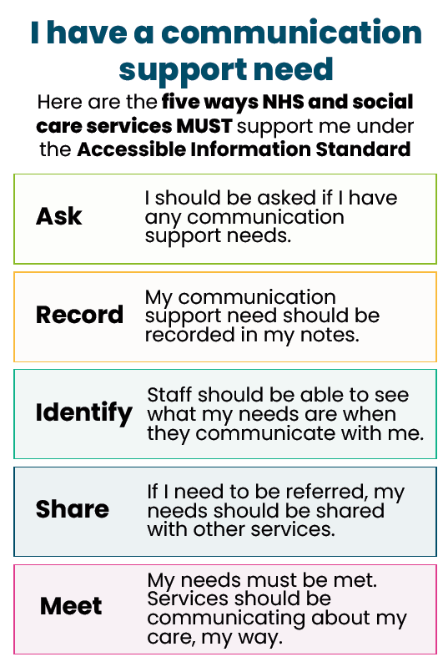
Accessible Information Standard

Slide 12
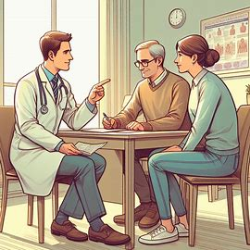
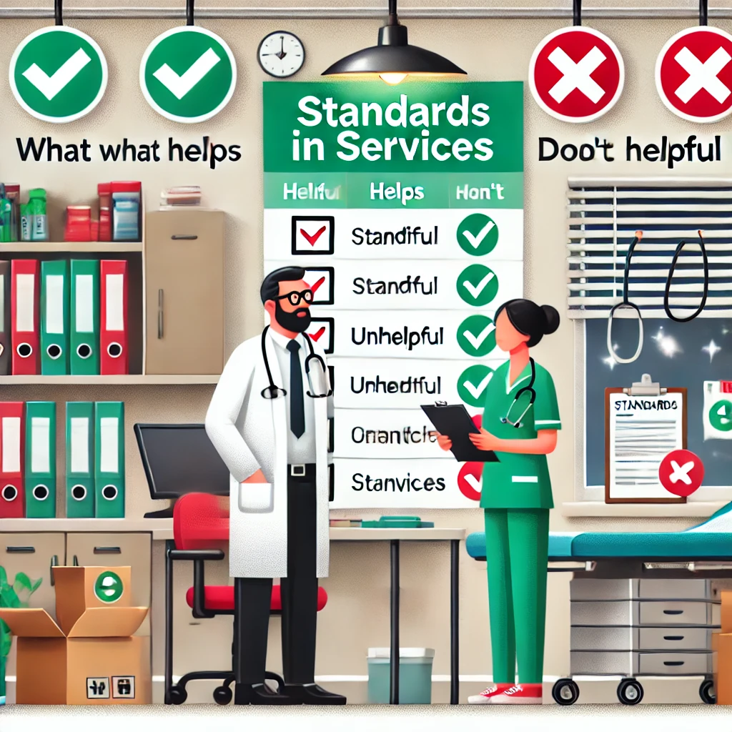

Accessible Information Standard
The aims of the South West London Healthwatch project were:
To listen to patients and their carers to understand how well GP practices meet their communication and information needs.
To understand what helps and hinders GP practices from delivering the Standard.
To facilitate discussions between GP staff, patients, and carers to find ways to improve together.

Slide 13
NHS App Get Well
Find NHS services
Use NHS 111 online
Book GP appointments
Manage secondary care appointments
Contact your GP using an online form
Search Health A-Z

Slide 14
NHS App Stay Well
View your prescription details
Order repeat prescriptions
Book a COVID or flu vaccination
Receive messages from your GP and healthcare providers

Slide 15
Get Well
NHS App Manage Your Health
View your health record
01
View test results
02
Nominate a pharmacy
03
View your NHS number
04
Register for a GP
05
Make an organ donation decision
06
Link account
07

Slide 16

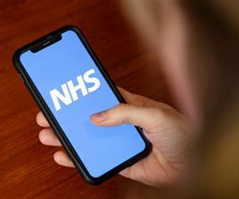
111: the NHS non-emergency number
What is NHS 111 ?
111 is a phone number you can call for advice if you feel unwell but it is not an emergency.
111 is free to call from landlines and mobile phones.
Or you can visit online at 111.nhs.uk
or use the NHS app.
The service is available 24 hours a day, every day of the year.

Slide 17
111: the NHS non-emergency number
Depending on what you need, 111 can:
arrange for you to see a GP in the evening or weekend at a Primary Care Centre
arrange for a GP to visit you at home
book a call back from a nurse or GP
arrange for you to see a pharmacist for prescriptions or help with a minor illness
provide advice to look after yourself safely at home
provide health information
request an ambulance to take you to hospital
advise you to call 999 or go to A&E in an emergency
advise you to go to an Urgent Treatment Centre
refer you to other services
get urgent specialist support, for dental or mental health problems
contact your own GP surgery

Slide 18
What Is Pharmacy First?
A national initiative to provide quicker access to healthcare
Community pharmacists can offer consultations for minor conditions
Aims to reduce pressure on GP practices and A&E
How Does It Work?
Pharmacist assesses and advises on treatment
Can supply prescription medication or advise on next steps
Pharmacies are able to help with multiple conditions and minor ailments.

Slide 19
The Role of Pharmacists
Highly trained in medicines and minor ailments
Can offer clinical assessments and recommend appropriate care
Work closely with GPs and other healthcare providers
Faster access to advice and treatment
Convenient locations with extended hours
No need to wait for a GP appointment
Expert advice from trained healthcare professionals
Benefits For Patients

Slide 20
How to access Pharmacy First
Walk into your local pharmacy and speak to the pharmacist about your symptoms
Self refer online through your practice website
GP referral to pharmacies.
Search Pharmacy First or use the NHS app for more information

Slide 21





Power to Connect
Bridging the Digital Divide: Empowering Our Community to Thrive Online
Access to Devices
We collect unused digital devices, refurbish them, and distribute them to those in need within our community
Connectivity
We provide free data SIMs to individuals without data access
Digital Skills Support
We provide free group workshops and one-on-one support on digital skills, online safety, financial literacy, healthcare access, job readiness, and getting started online.
Wrap Around Digital Inclusion Support
We offer IT maintenance advice and referrals to community services and support ensuring ongoing digital confidence and independence.

Slide 22

How can we help?
"I knew nothing about using computers. Now, I’m connecting with family, doing my shopping online, ordering prescriptions and using it to my advantage. It’s truly improved my life, and I’m learning so much about the online world.
  Supporting your Access to Online Healthcare
  Assistance with using the NHS App, booking GP appointments and managing prescription online
  Guidance on apps to improve health, wellbeing and quality of life
  If you’re feeling overwhelmed by technology and unsure where to start or what to trust
  Access to devices and data
www.powertoconnect.co.uk
hello@powertoconnect.co.uk
07934553192

Slide 23
BME Forum / Macmillan
Cancer Support
Our ‘Can You C Me?’ partnership with Macmillan Cancer Support is focusing and taking action to improve healthcare outcomes for Black and Ethnic Minorities affected by cancer.
Our Croydon Cancer Conference (CCC) in November of 2022 identified a critical need to address racial disparities within patient experience and health outcomes when receiving a cancer diagnosis.
Find us across six South West London boroughs, Croydon, Merton, Wandsworth, Sutton, Richmond, and Kingston, to build trust, educate and extend reach to support the demographic who are evidently deprived of care and support they should expect.

Slide 24
BME Forum / Macmillan
Cancer Support
We are working alongside healthcare providers, places of faith, housing support providers, care homes, Macmillan Support Centres, and many other organisations within the community to reach out to individuals and ensure everyone has accessible support after a cancer diagnosis.
Receiving a cancer diagnosis can affect every aspect of your life. If you are in need of financial support, emotional support or just a sense of direction or someone to offload on, we are here.
If you or anyone you know is affected by cancer, please get in touch today.

Slide 25
Wandsworth Primary Care Patient Forum
Our aims:
To support each others patient groups
Address the problem of practices without groups
Restore the line of communication to and from NHS primary care commissioners
Collaborate with key players such as NHS Wandsworth, GP Federation, Local Medical Council and Healthwatch to improve the quality of primary care
We have made contact with established patient reps in 26 practices.
We aim to have every practice represented at the Forum!

Slide 26
Wandsworth Primary Care Patient Forum
We meet every two months, usually at the Baptist Church on East Hill.
We have regular presentations on topics of interest, including by the Primary Care Management Team and the GP Federation, and reports from practice groups.
We share a report on each event as widely as possible to all interested parties.

Slide 27
Wandsworth Primary Care Patient Forum
How many of you are registered with a GP Practice in Wandsworth?
How many of you have joined your Practice Patient Group?
If not - How can you join your group?
We can advise on setting up or developing a patient group in your practice, or if there are issues you wish to raise at our forum meetings.
Also get in touch if you would like to attend meetings or receive copies of our reports.

