Slide 1




Healthwatch Assembly
Accessing non-urgent care

Slide 2
Reminders:
We will record this meeting
– turn off your camera if you don’t want to appear
Mute during presentations
You can put questions in the chat box
Presentations will be available after the event on our website
Contact us afterwards if you want to share something you don’t want to share during the meeting.

Slide 3

Healthwatch Wandsworth
Health and Social Care Act 2012 established Healthwatch in English local authority areas and Healthwatch England to bring us together.
Independent champion for people using health and social care in Wandsworth.
Through community outreach and interviews we listen to peoples’ experiences of services and offer insight about their real experiences and what they want and need to the people who can make changes.
Working with health and social care services to
improve health and social care.
Events, newsletters, website keep
people informed and participating.

Slide 4
What we did
March 2023 – online event discussing GP services.
Heard about developments in primary care.
Discussed: What does good access look like? What does good
coordination and continuity of care look like? And, how can
we promote wellness through prevention?
  Over the past year we have continued to hear that accessing
  health care is one of the most common topics for local
  people.
  Read more about what we did:
  https://www.healthwatchwandsworth.co.uk/sites/healthwatchwandsworth.co.uk/files/Format%20report%202023%201.2.pdf

Slide 5
Key points raised
Getting an appointment, availability and how people can access (having telephone, digital, and face-to-face appointments were suggested to ensure accessibility and appropriate triaging)
Improving access: including supporting patients in using digital access apps, promoting the use of the NHS app for prescription orders, providing clear information about care pathways, and offering various ways to make initial contact.
Continuity: of access to the same GP where possible or not repeating medical history. Shared records.

Slide 6
Key points raised
Keeping well: signposting, beyond the NHS (community champions and events and social prescribing links with support groups) , Health checks, sharing good practice and specific GPs for vulnerable people, early intervention information about mental health, social isolation and education. Social prescribing beyond GP practices.
Transparency about how things are working at surgeries
Increasing access to community based services

Slide 7
Today’s topic – accessing care
The point at which you access care – the NHS call this Primary Care.
- general practitioners, dentists, opticians and community healthcare. For common health concerns, preventative care, and manage chronic conditions.
- Not emergency care (e.g. A & E) or planned care and hospital care (e.g. specialist appointments, treatments or surgery).
- Attempts to increase access to care: including the options places we can go to get help. E.g. new technology, different staff who can help at GP surgeries or elsewhere.
Here’s a quick tour of a what’s new. Many new ideas are still at the beginning of being implemented and will take time to develop.

Slide 8
Today’s topic – accessing care
Aiming to answer most of the points raised at our previous event.
Gather more of your questions to help us know what people need more information about.
Agenda
1. Overview of Dentistry, Pharmacy and help in the community
2. Focus on GP services and Q & A
3. Collaboration, co-ordination and shared records – Integrated care developments and discussion

Slide 9
Dental services
People have told us that getting a dental appointment is difficult.
Waiting to see the impact of a recent Government strategy to increase the number of new patients taken on and NHS appointments and we will monitor what might change.
Website: ‘NHS Search for A Dentist’
Your dentist doesn’t have to be close to where you live.
Dentists get paid per treatment, not per patient and don’t formally ‘register’ patients. Dentists may put you on an informal list.
Dental charges. Some people are exempt, but if you don’t qualify for this, you could qualify for help to towards costs NHS low income scheme.
Link: What the new dental recovery plan means for you
Notes:
https://www.nhs.uk/service-search/find-a-dentist

Slide 10
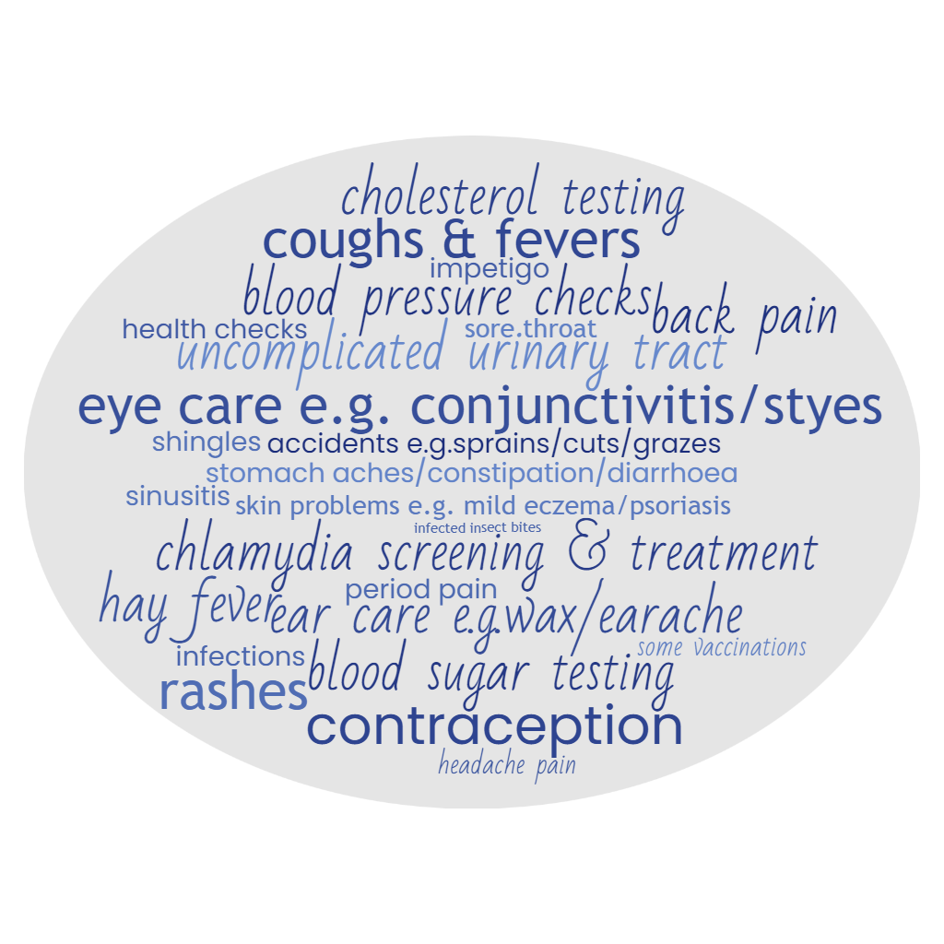
Pharmacy services
Can help with more things
Refer on to other health
care or doctor if
needed
Private rooms
Open evenings
and weekends
Qualified health
professionals
(at least 5 years
training in medicines)
Website: Find what is on offer near you ‘NHS find a pharmacy’
Notes:
https://www.nhs.uk/service-search/pharmacy/find-a-pharmacy
Earache - 1 to 17 years.
Impetigo - 1 year and over.
Infected insect bites - 1 year and over.
Shingles - 18 years and over.
Sinusitis - 12 years and over.
Sore throat - 5 years and over.
Uncomplicated urinary tract infections - women 16-64 years.
Advice on using and disposing of medicines.
Contraception.
Blood pressure checks.
Chlamydia screening and treatment.
Quitting smoking.
Cholesterol and blood sugar testing.
Drug use - including needle and syringe exchange schemes.
Help on how to manage your weight.
Some vaccinations.
ches and pains - such as, back pain, headache and period pain.
Accidents - such as, sprains, minor cuts, and grazes
Colds, flu and other infections - such as, cough, congestion, fevers and/or temperature.
Ear care - such as, ear wax.
Eye care - such as, conjunctivitis, styes.
Hay fever - which is not controlled by standard over-the-counter treatments.
Rashes.
Skin problems - such as, athlete’s foot, cold sores, or mild eczema or psoriasis.
Stomach aches - such as, constipation, diarrhoea, or indigestion.
Pharmacy First - getting the most from your pharmacist | Patient
Find a pharmacy - NHS (www.nhs.uk)
Earache, Impetigo, Infected~insect~bites, Shingles, Sinusitis, Sore~throat, Uncomplicated~urinary~tract~ infections, Contraception, blood~pressure~checks, Chlamydia~screening~&~treatment, Cholesterol~testing, blood~sugar~testing, some~vaccinations, back~pain, headache~pain, period~pain, Accidents~e.g.sprains~cuts~grazes, coughs~&~fevers, ear~care~e.g.wax, eye~care~e.g.~conjunctivitis~&~styes, Hay~fever, Rashes, Skin~problems~e.g.~mild~eczema/psoriasis, Stomach~aches/constipation/diarrhoea, health~checks

Slide 11
Direct access
You can get access to some health care without seeing the GP (Self-referral routes)
  Talking Therapies for emotional and mental health (Link)
  Minor Eye Conditions Service (Link)
  Joint and Muscle Pain Get U Better App (Link)
  Learning about diabetes (Link)
  Sexual health services (Link)
  The NHS Strategy aims for more services to be available soon, such as hearing support, weight management, podiatry and equipment services.
Health checks

Slide 12
Community-based help
New ways helping people know more about keeping well and reaching people that might need to get health support.
Aim = better detection of issues, prevention and better management of conditions.
Community champions – local volunteers help their community understand health issues, share health information and improve connections between services and communities.
Battersea Community Health and Wellbeing Workers - visit people in their homes to provide advice and connect them to NHS, council and voluntary sector support. Focus on everything that affects health.
Social prescribing in GP practices and beyond – discuss wider social, emotional and practical needs of patients and connect them with to groups, activities and services to help.
Integrated neighbourhood teams will be mentioned later.
Notes:
Pilot health project restores lives of people in chronic pain - South West London ICS

Slide 13
Results or e.gs of community-based help.
Introducing Thomas Herweijer (NHS South West London ICB)

Slide 14
GP services
NHS SW London ICB are analysing data about appointments to understand how long it takes to get one. In November 2023 nearly 140,000 more GP appointments happened in SW London compared to November 2019.
Get your appoint via an online form
Many surgeries are using a system to manage the requests they get. Most people will have noticed the change. Those who cannot use an online form can still phone their GP practice.
Each surgery is different – many, but not all will also make appointments by phone and other ways. But, behind the scenes staff often use a single system to manage.
Notes:
six in 10 GP practices have already modernised their telephone systems - the remainder will do by March Tens of thousands more people a month receive GP appointments compared to before the pandemic - NHS South West London Integrated Care Board (icb.nhs.uk)

Slide 15
GP services
The availability of GP appointments is limited, but this co-ordination helps them get you an appointment with other new staff with expertise to help with some things.
Nurse Practitioners: These nurses can assess and treat minor illnesses, provide health advice, and perform certain procedures.
Paramedics: Some surgeries have paramedics who assist with urgent care needs.
Pharmacists: Pharmacists offer medication advice and can help manage prescriptions.
Physiotherapists: They specialise in joint and muscle issues (musculoskeletal) and rehabilitation.

Slide 16
GP services
You can now do more things with the NHS App
Book appointments, order prescriptions, decide where you want to get hospital treatment, view your health records, use NHS 111 for instant advice
Some surgeries allow you to contact them via the app, access the information for someone you care for, view and manage hospital appointments, view and manage care plans
Support for using the NHS App.
Digital Care Coordinator in Wandsworth will be working closely with GPs, pharmacists, and other organisations to support, facilitate and educate on the use of digital healthcare services.
Notes:
Report: Patient Perspectives on Digital Access to Primary Care - Health Innovation Network

Slide 17
Quick poll
Question 1. Before this event how much did you already know about the following?
How to get a dentist appointment
Pharmacy services
Direct access
Community based help
Getting a GP appointment
The NHS App
Question 2: What would you like to know more about?

Slide 18
Q & A
This will help us know what people want more information about.
Dr Nicola Jones and Dr Devin Gray will try to answer some of the questions, but we won’t have time for all.
Andraya Catlyn also joins us in her new role as Digital Care Coordinator for Wandsworth

Slide 19
Collaboration and integration
Last year people said they wanted to see
  more sharing of records
  more collaboration between health and care services
  Better continuity of care
SWL ICB are starting to plan how this could work
Focus on neighbourhoods and integrated neighbourhood teams
Move from re-active care
Joined up and shared care records so people only tell their story once
Some interesting project start points to build on.

Slide 20
Progress
A few highlights on recent progress from James Walker Deputy Director of Primary Care Transformation, Merton and Wandsworth, NHS South West London ICB
A few highlights on recent progress from Mark Steed Associate Director of Operations, Battersea Healthcare CIC

Slide 21
Questions
Give examples about what would make a difference in managing your health?
E.g.
What needs to happen so that your care staff understand you, your culture and your lifestyle?
How could you be more involved in managing your own health?
How could you and your care staff be more pro-active and joined up?
What information or choices might be useful?

Slide 22
Feedback and responses

Slide 23
Keep up to date or get involved
Things will continue to change keep up to date
Become a Healthwatch member for free and get the Healthwatch Newsletter (Link)
SWL ICB newsletter (Link)
GP practice – Patient Participation Group (PPG)
PPG Forum
GP practice events
Become a health champion (Link)
Join Thinking Partners: Topic based meetings you can attend based on your interest (Link)

Slide 24
How was it?
Was today’s event useful?
Please select if any of the following was useful (you can pick more than one):
  I found out something about health and social care
  I shared my experiences
  I learnt about how to get health and social care services
  I learnt more about how to get involved in how health and social care services work
  I found something else useful
  No - I didn’t find the event useful
  Please more feedback if you want to.

Slide 25
And finally
We are working with Healthwatch in South West London to understand how GP surgeries are meeting the communication and information needs of people with certain disabilities or conditions such as people with sensory loss, certain neurological conditions, people who are neurodiverse and/or have a learning disability.
We’ll update more on how this progresses in our Newsletter so become a member to hear more.

Slide 26
Thank you

