Slide 1
Citizens Advice Wandsworth – Healthwatch Presentation
Michelle Rose
24th October 2024

Slide 2
Introduction
Who we are
Who we help
What we help with
Accessing our services
Cost of living
Health Inequalities Fund

Slide 3
Who we are
200 offices first established in 1939, making 2024 our 85th anniversary.
Local and independent charities, helping with a wide range of social welfare issues but using different delivery models.
4 in 10 people will use a Citizens Advice service in their lifetime.
Notes:
Source: https://web.archive.org/web/20151118063956/https://www.citizensadvice.org.uk/about-us/difference-we-make/what-we-do-and-how-we-can-help/

Slide 4
Diverse team of 45 staff and 75 volunteers, aged from early 20’s to 80’s.
18+ funding streams including:
Local authority and local NHS
Greater London Authority
Grant funders e.g. lottery
Contracts to provide services
Advice services specialise in casework support and welfare benefits issues.
Record around £6m in financial gains per year for clients.
Notes:
We are a free, independent, impartial and confidential service. We provide our Core service, specialist advice and community engagement
Specialist advice: Project funded, casework support
Community engagement: Training (AFA), network building, partnerships

Slide 5
Who we help
Notes:
Source: Internal monitoring data for August 2023 to August 2024 and Census 2021 for Wandsworth

Slide 7
Notes:
Source: Internal monitoring data for August 2023 to August 2024 and Census 2021 for Wandsworth

Slide 8
What we help with
Benefits
GVA and hate crime
Charitable support and food banks
Education
Health and community care
Tax
Travel and transport
Utilities
Housing
Debt and money
Employment
Consumer
Immigration
Legal
Relationships and family
Other
Notes:
Core service: Traditional, access points, volunteers
Specialist advice: Project funded, casework support
Community engagement: Training (AFA), network building, partnerships
Most common benefits issues for older people are AA, PC and HB, with making and managing a claim the most common sub-issue.

Slide 9
Notes:
Most common benefits issues for older people are AA, PC and HB, with making and managing a claim the most common sub-issue.

Slide 10
Cost of living
“The problems we're helping people with are more complex, urgent and harder to solve… there are an increasing number of people, seeing us with an increasing number of problems that are increasingly deep.”
Rate of increase in need is slowing.
We don’t know if it will settle at a new high, ‘the new normal’ rather than a crisis.
People of colour and people with disabilities have been disproportionately affected and experienced most harm.
* Citizens Advice Data Insight events - https://www.eventbrite.co.uk/o/citizens-advice-policy-team-45816434643
Notes:
Quote from Tom MacInnes, Head of Policy at national Citizens Advice
Cost of Living Monthly Data Insight Events on Eventbright - https://www.eventbrite.co.uk/o/citizens-advice-policy-team-45816434643

Slide 11
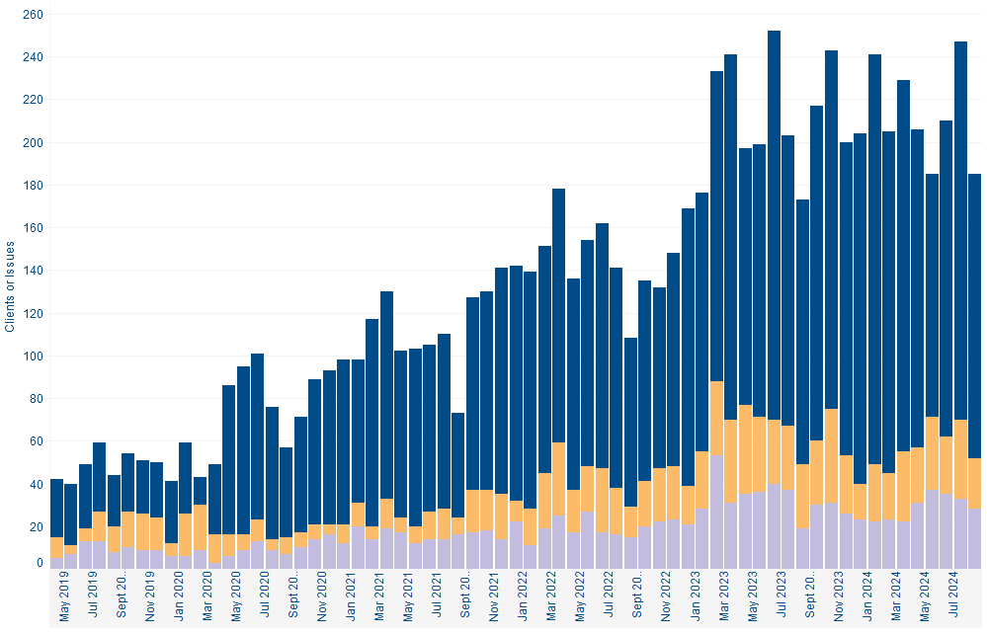
Charitable support and food banks
Council tax arrears
Energy debts
Notes:
Source: Internal monitoring data for 2019 to present.

Slide 12
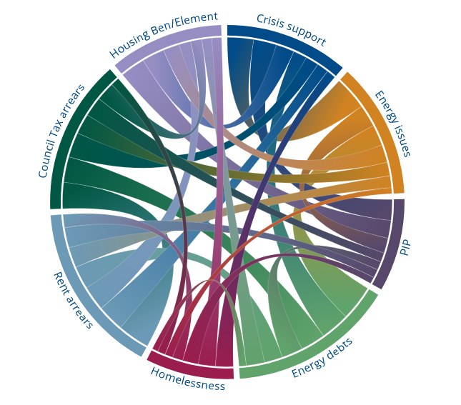
Notes:
Source: https://public.flourish.studio/visualisation/15159226/
Clients with CT arrears then may have an problem with their HB/HCE and may need Crisis Support; Clients with rent arrears may be threatened with homelessness.
12

Slide 13
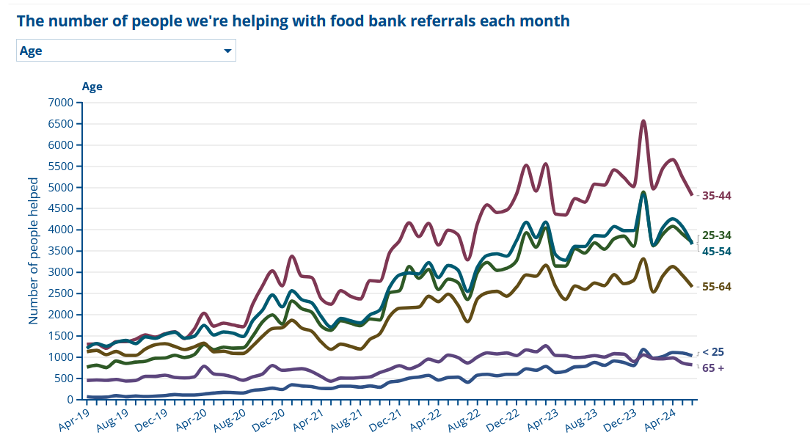
Notes:
Source: https://public.flourish.studio/visualisation/10725077/
13

Slide 14
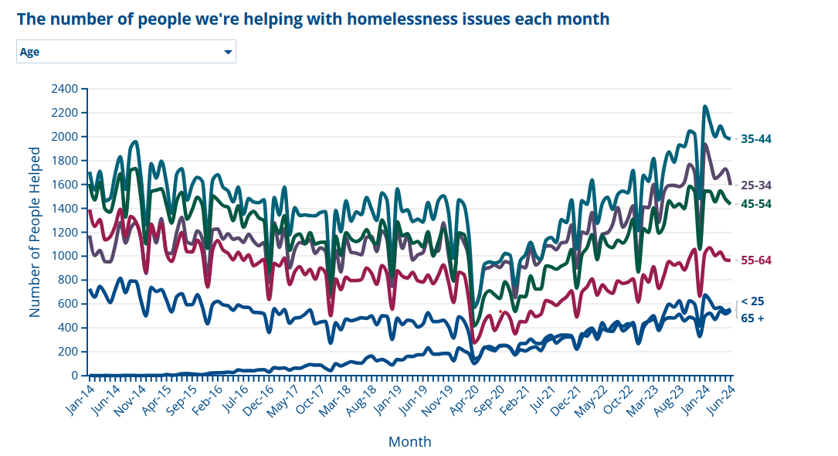
Notes:
Source: https://public.flourish.studio/visualisation/10881959/
14

Slide 15
Three key issues for older people
Pension Credit and Winter Fuel Payment:
2024 qualifying week is 16 to 22 September​, making 21 December last date to backdate claim and qualify​
16 week claim processing time before announcement, number of claims has now doubled
PC alone worth up to £3,300/ year but not paid automatically - estimated £1.7b unclaimed
What to look out for:
No private or occupational pension
Not receiving full state pension
Struggling to make ends meet on pension alone
Notes:
Source: www.gov.uk/government/statistics/weekly-pension-credit-claims-received-from-1-april-2024-to-1-september-2024/weekly-pension-credit-claims-received-from-1-april-2024-to-1-September-2024. You must live in England, Scotland or Wales and have reached State Pension age to qualify for Pension Credit.

Slide 16
Attendance Allowance:
For people who need help with close personal care
Worth up to £5,644/ year
Estimated £5.2b/year unclaimed by older people
What to look out for:
Needs help around home
Difficulty dressing, bathing, preparing food, etc
Social isolation:
Health inequalities Project launching this month
Remit is to improve connections between people to advice services available to improve health outcomes

Slide 17
Cost of Living - Steps
Short-term help with food and essentials
Increase income
Reduce costs
Get advice
Get help with one-off costs
Get support
Notes:
Most people struggling with cost of living have multiple issues – often there are immediate crisis issues but also longer term problems - it can be hard to know where to start with untangling all the different issues
At Citizens advice when someone comes to us with cost of living problems we break it down into steps
We look at each of these steps in turn and look at what resources there are, what you can help people with and when people need to be referred for advice
Intro CoL checklist

Slide 18
CAW Cost of Living Project
Citizens Advice Wandsworth Cost of Living Checklist:
https://cawandsworth.org/wp-content/uploads/2023/12/2312-Cost-of-Living-Checklist.pdf

Slide 19
Short-term help with food and essentials
Food banks and community support
Crisis Assistance Grants
Low Cost food projects

Slide 20
Where can you find information about short-term help?
https://www.wandsworth.gov.uk/cost-of-living-hub/
https://cawandsworth.org/
trusselltrust.org/get-help/find-a-foodbank
Notes:
Most councils have a section on their website about cost of living – some have hubs or networks – usually these will list all the local foodbanks, resources, grants etc.

Slide 21
Increase your income - Benefits and Tax Credits
Check what you might get using a benefits calculator:
www.entitledto.co.uk
http://www.turn2us.org.uk
Help to Claim service can check if you can get or would be better off on Universal Credit:
0800 144 8 444 (Monday to Friday, 8AM to 6PM)
www.citizensadvice.org.uk/about-us/contact-us/contact-us/help-to-claim

Slide 22
Wandsworth Council Grants
Discretionary Social Fund (DSF)​ Crisis Assistance
Discretionary Housing Payments (DHP)
Community Care Grant (CCG)
Notes:
Discretionary Social Fund (DSF)​ Crisis Assistance – this fund provides food (supermarket) and fuel (gas/electric) vouchers​​
Discretionary Housing Payments (DHP) - financial assistance for people receiving Housing Benefit or Universal Credit, including a housing element, who require further financial assistance with housing costs because their benefit does not cover their full rent​
Community Care Grant (CCG) - provides furniture and white goods to those who fit the eligibility criteria

Slide 23
Increase your income – Cost of Living Support Wandsworth
School Uniform - vouchers available for pupils eligible for free school meals and moving into Reception or Year 7
Food vouchers for children on free school meals over school holidays
Wandsworth Council Cost of Living Hub
https://www.wandsworth.gov.uk/cost-of-living-hub/
Notes:
Any awards made will be at least eight weeks apart and subject to a maximum of three awards in the 12-month period from 1 April 2024 to 31 March 2025.
Awards will be calculated using the following table:
Level of awards
Household type
Award
Single person
£35
Lone parent
£55
Couple
£70
Dependant child
£40
Up to a maximum award of £230.
Fuel allowance
An additional allowance is payable where an applicant has a prepaid meter or is the named bill payer:
Couple without Children/Single People: £30 (£15 Gas + £15 Electricity)
Households with children: £50 (£25 Gas + £25 Electricity)

Slide 24
Reduce your costs
Rent/Mortgage
Fuel/Water
Council Tax
Prescriptions
Phone/Internet
Travel
Help with one-off costs – white goods, furniture
Referrals for debt advice

Slide 25
Get help with one-off costs
Universal Credit budgeting advance
Charitable grants grants-search.turn2us.org.uk.
Notes:
Benefit advances
Universal Credit budgeting advance is a no-interest loan that you pay off over 12 months by getting reduced payments www.citizensadvice.org.uk/benefits/universal-credit/on-universal-credit/budgeting-advance
Council grants
A Community Care Grant can help you pay for items like furniture or white goods. There are eligibility criteria, including that you aren’t eligible for an advance payment on any benefits you receive.
Charitable grants
Charitable grants can help pay for one-off costs such as furniture or carpeting. Most require a referral from someone like a support worker or debt advisor. Use the Turn2Us website to check for grants and read about how to apply for them: grants-search.turn2us.org.uk.

Slide 26
Get advice
Citizens Advice Wandsworth: https://cawandsworth.org/
Age UK : https://www.ageuk.org.uk/wandsworth/
Carers Centre: https://carerswandsworth.org.uk/information-advice/

Slide 27
CAW Cost of Living Project
A team of 6 (manager, casework supervisor, two advisers and two assessors).
The project will provide vital resources to respond quickly when residents face immediate hardship due to financial issues.
We'll work on:
Income maximisation through identifying entitlement to cost-of-living specific schemes, other benefits and non-statutory sources of support.
Reducing expenditure by advising about budgeting and energy efficiency, as well as referring for specialist debt advice.
Resolving underlying issues, for instance the benefit cap or clients not getting the right level of disability benefits.
Referral via CAW Webform

Slide 28
Accessing our services
Call our Adviceline on 0808 278 7833 and press option 4
Open 10am to 4pm, Monday to Friday
We answer most calls within 45 minutes but calls are free from a UK mobile or landline
It generally takes less time to get through on Wednesdays, Thursdays, Fridays, and after 2pm
Online at cawandsworth.org
Easiest way to refer
Some issues handled through email advice

Slide 29
Visit our offices:
Very busy at peak times
Will help people who can’t use phone or online, and try to deal with urgent issues
May direct some people to other channels, depending on our capacity and their need/capability
Referral partners:
GPs and social prescribers
Council officers
Foodbanks
Social workers
Voluntary sector, 40+ organisations on Refernet

Slide 30
Health Inequalities Fund
Funded by the NHS South West London ICB
In partnerships with the Wandsworth Care Alliance
We want to break down barriers to enable better welfare inequalities outcomes for people in Wandsworth
Studies show that local socially isolated people may struggle to access welfare and legal advice (particularly those from multiple less advantaged groups).

Slide 31
Black/Asian/ other Global majority (BAGME)
Asylum Seekers / refugees
ICB have identified 6 themes that correlate to poor health outcomes
Learning disabilities/autism
LGBTQIA+
Socially isolated people
Young/unpaid carers

Slide 32
Health Inequalities Fund
Not just react to inequalities but also prevent inequalities.
Help people to live well and stay well.
Studies show that local socially isolated people may struggle to access welfare and legal advice (particularly those from multiple less advantaged groups).
A good standard of living and protected rights are needed for people to stay healthy.

Slide 33
Citizens Advice Wandsworth Health Inequalities project:
Develop a communications programme with charities/community groups – to improve access and understanding of welfare and legal advice
Improve referrals to advice services from socially isolated groups
Include monthly communications, quarterly newsletter, face to face meetings
Case studies – to highlight impact that good advice helps to transform people’s lives, better connect people and increase health outcomes
Qualitative research – providing case studies that highlight the role that accessing advice can have on reducing health inequalities
Research into the role of digital exclusion in preventing access to advice in Wandsworth.
Notes:
Get involved – sign up to our mailing lists, particularly if you work with people that are from less advantaged groups.
To begin with we will be focusing on the themes of Keeping Warm/Energy efficiency/ e-visas

Slide 34
Thank you

