Slide 1
Commissioning Intentions 2018/2019
Merton and Wandsworth
Local Transformation Board
Debbie Baronti
Head of Planning Wandsworth CCG

Slide 2
Commissioning Intentions Merton and Wandsworth Local Transformation Board
Context and background to development
Key initiatives and local delivery - what does this mean for you?
Opportunities & challenges
Case study integrated care –a patient journey

Slide 3
What are Commissioning Intentions and how are they developed?
Commissioning intentions outline the actions we will take to improve health outcomes for our local population
Background to development
Five Year Forward View
SWL - Sustainability Transformation Plan & Commissioning Intentions
Financial position and NHS England directions
Local priorities for Merton & Wandsworth
Local Transformation Board
Partnerships that lead and develop delivery of local care models, improving
outcomes for local residents.
Aligned to the South West London commissioning intentions
SWL
LTB
CCGs
GPs/Localities/Patient Groups

Slide 4
STP Deliverables – Proactive, accessible & appropriate
Right Care, Right Time, Right Setting
Delivering care closer to home
Focus on keeping people healthy and out of hospital – hospitalisation can lead to a reduction in independence
Early intervention - providing the right support at home so people don’t need to be admitted to hospital
Improving quality of life & support for people at end of life
Keeping people well at home & improving care for residents of care homes
Supporting enhanced primary/community services to be delivered on a locality basis to align with the primary care model of care
Increase access to GPs and community based urgent and emergency care
Increasing access to community based crisis care and home based integrated care packages
Embed triage and navigation – to help people to access urgent/emergency care support that is appropriate to their need
Making best use of acute resources to deliver timely and effective urgent and emergency care
One stop shop models of care where clinical and diagnostic treatment plans are delivered in one visit
Notes:
Important part of this slide is the message of the STP interventions being :
Proactive
Accessible
Appropriate
Some examples are listed here around urgent and emergency care and community/care closer to home and looking at making the system work better together such as community and primary care
The development of crisis cafes example to support those with mental health needs
E- fragility project identifying patients at risk of ending up in hospital working with GPs and voluntary sector in an integrated approach

Slide 5
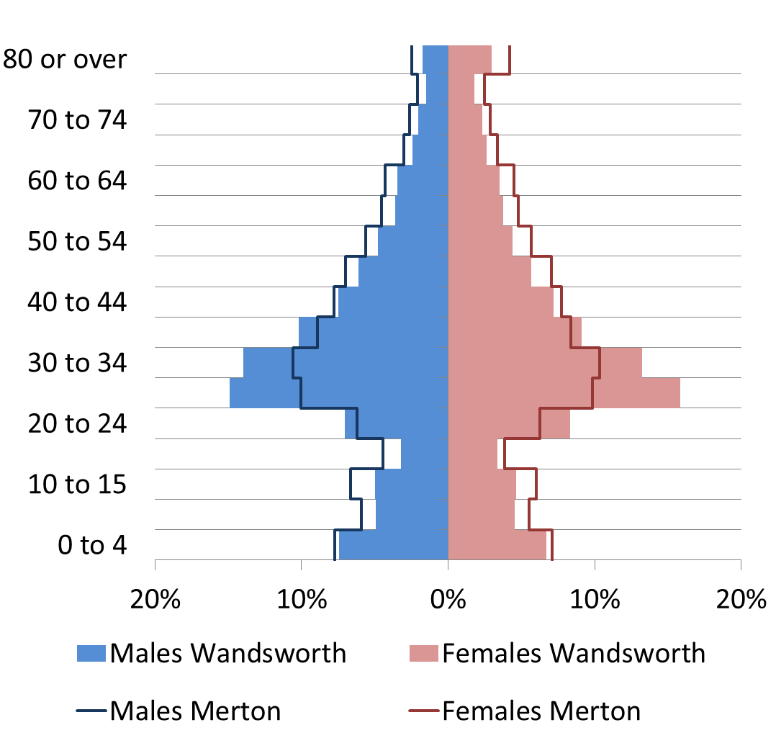
The local populations
Morbidity in adults
Statements of Educational Need for children have risen across both areas
Wandsworth has a larger population, with a higher % of 25-35 year olds
An additional 1000 people in each borough will have restricted mobility by 2025
Wandsworth
Merton
348,000
207,000
5% 2026
4% 2021
206,000 in 2016
In the population aged over 65 there will be an increase in diagnosed dementia by 600 in Wandsworth and 500 in Merton by 2025. The combined total will be 5,000 across both areas
321,000 in 2016
By 2026 the Merton population is not expected to grow significantly, with Nine Elms the Wandsworth population will grow by 27,000

Slide 6
System Impact - 6 commissioning programmes (1/2)
Right Care, Right Time, Right Setting
Urgent Care | Primary Care | Integrated Care
Appropriate use of ambulance call outs Using alternatives to A&E to reduce inappropriate A&E attendances and emergency admissions | 8-8, E- consultation, direct booking from A&E, 111 & OOH Continued roll out of the Multispecialty Community Provider model Diagnostic Services –access to a range of diagnostic services locally | Improving intermediate care and reablement to support people to remain independent at home Ensuring delays in discharge from hospital are reduced
Initiatives
Alternative Care Pathways Rapid Response home visits Extending the Frequent Attenders initiative Front door streaming at A&E Older People’s Advice & Liaison (at SGH front door) | 111 direct booking to UTC and primary care Expand Rapid Access Clinic (QMH and Nelson) Expand Enhanced Care Pathway | Rapid response in reach to Nursing Homes Extend red bag scheme Community based short term step up beds Reduce CHC assessments carried out in hospital (D2A) to <15% Extend access to integrated health and care reablement

Slide 7
System Impact - 6 commissioning programmes (2/2)
Right Care, Right Time, Right Setting
Mental Health | Planned Care | Children
Making psychological therapies more accessible & responsive in crisis situations Ensuring an integrated approach to physical health in those with mental illness | Ensuring good use of hospital beds – so that patients are only in hospital for as long as necessary and are supported on discharge Providing community based outpatient clinics | Proactive case management and integrated care planning for children with complex needs and Long Term Conditions
Initiatives
Improve access and recovery rates for IAPT Improve access to community based CAMHS crisis response Increase uptake of IAPT for people with LTCs | Extend diabetes community model to management of other LTCs Increase access to virtual consultant advice across all specialties, including real time advice where agreed. | Proactive case management & integrated care planning for children with complex needs & LTCs, Review school based therapies service

Slide 8
What will this mean for you ?
Care will be:
Patient centred
Proactive and preventative to support people earlier in the pathway
Integrated, holistic and personalised to improve patient outcomes and significantly reduce avoidable/unnecessary attendance/admission to hospital
Provided out of hospital and closer to patients’ homes where appropriate
Targeted to reduce health inequalities
The promotion of patient self-care will improve patient health and well-being and encourage better self-management of conditions.
Notes:
How will the commissioning intentions make a difference to you as a patient
What benefits will you see
What will future clinical pathways look like

Slide 9
Opportunities and challenges
Clearer patient pathways
Reducing inappropriate use of acute services
Improving access to community services and care closer to home
Improving discharges from hospital
Making the system work better together e.g. looking at integrated approach across programme
We want to make the patient journey better but we also need to be mindful of financial constraints
New approaches
First time provider Cost Improvement Plans are considered and built into Commissioning Intentions - recognition we are one health economy across the STP.
Agreement transformation can bring longer term benefit to patient care and affordability but needs careful management
Need to explore ways to develop fair and transparent ways of working across the local health and care economy.
Notes:
So what are the opportunities and challenges
QIPP target – to achieve the QIPP required we need to take the programme approach and not multiple small projects.
We need system change and for the first time the QIPP and CIP (Cost improvement plans) are being built into the commissioning intentions

Slide 10
Case Study
A Patient Journey Integrated Care
Jane French
Commissioning Manager Older People & Integrated Care

Slide 11
Reintroducing Doris and Maurice
Doris and Maurice are both 80 years old and live independently in their own home in Wandsworth
They have one child, who lives nearby, and very supportive neighbours
Both have chronic physical health problems (including diabetes and Parkinson’s); Maurice is becoming increasingly confused and Doris has had several admissions to hospital in the last year. After each, she is more dependent than before
Doris and Maurice regularly see their GP, community nurses, hospital specialists, social care reablement team, dementia service and voluntary sector agencies
They think the GP is wonderful but really don’t want to bother her; it takes so long to get an appointment, she must be very busy
They don’t mind seeing many different professionals but it doesn’t help with Bob’s confusion and they are frustrated by repeating so much
Most of all they are concerned about how they will manage the next stage of their lives

Slide 12
How do we want to work together to support Doris and Maurice?
Currently
Complicated
Gaps
Inefficient
Reactive
‘hands off’
Fragmented
Disruptive
Isolating
What we want
Joined up
Efficient
Proactive
Give control and choice
Navigated
Integrated
Continuity of care
Connected

Slide 13
Wandsworth Integrated Health and Social Care
Preventative
Reactive
Social Prescribing
Self Management
Patient Education
Community advice and referral service (CAB)
Rapid response
Quickstart social care
Integrated hospital discharge team
Housing adaptations
Geriatric Holistic assessment
Short term step up beds
Better Care at Home
Mental and physical health care
Proactive
Risk Stratification
Enhanced Care Pathway
Multidisciplinary Locality Teams
Health and Social Care Coordinators

Slide 14
Thank you
Debbie.Baronti@swlondon.nhs.uk
Jane.French@swlondon.nhs.uk

