Slide 1
Wellbeing Service

Slide 2
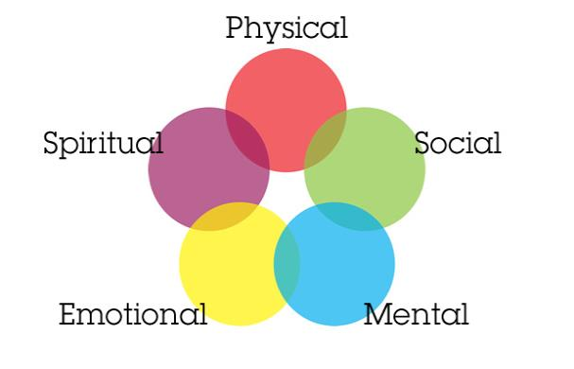
What is wellbeing?
Managing your wellbeing increases your resilience, making you more able to manage stressful life situations and helps you to live a more positive lifestyle
Notes:
What is wellbeing -
Explain 5 areas of wellbeing:
Physical- taking care of your physical health such as sleep, eating, exercise. = reduces risk of certain diseases, boosts overall energy and
Social- having a social support network where you feel supported and experience a sense of belonging is important, as it provides instrumental and emotional support.
Mental- Being able to keep your brain active by learning new skills or carrying out activities which encourage thinking. A stimulated brain improves your self-esteem and motivation.
Emotional- Being able to acknowledge and positively deal with your emotions is vital for positive wellbeing. Often we tend to ignore or latch onto negative emotions instead of positively processing them. Therefore, we need to be able to mindfully deal with our emotions by accepting the emotion, recognising that our emotions are impermanent and understand why we are experiencing that emotion.
Spiritual- This is anything that brings you a sense of peace and hope for the future. This is not necessarily religious (for some it may be), but it can also be practicing yoga, meditation, mindfulness, a small act of kindness etc.

Slide 3
How we work with the community
1. Meet with organisation manager/lead
2. Identify their requirements and what the groups needs are
3. Tailor the workshop to meet these needs
SHARE Community
CARAS for Young People
AGE UK
Wandsworth Carers Centre
Notes:
The wellbeing team at TW, work with the different communities within Wandsworth. Our goal is to be able to reach out and support those communities who are often overlooked in mental health services, and be able to provide a tailored, helpful service for them.
First we meet with the organisation manager/project lead and we discuss the client group with them. During this discussion we are able to identify the groups specific needs, understand how we may provide support for this group and come to an agreement with what we may do. Following this discussion we tailor the workshops for the client group to ensure that the workshop is fully adapted and understood by them.
For example:
SHARE community- learning disability clients with various sensory needs. We learnt that this group required support to understand wellbeing, emotions and how to deal with emotions, understand how to maintain healthy relationships and use boundaries. We ensured the workshop slides were more picture based and made the sessions activity based to ensure better understanding.
CARAS for Young People- young people who immigrated to London from their countries, leaving their families and homes behind for safety. English is not their first language, and have experienced past trauma. The workshops were tailored by ensuring there were different languages on the slides, basic English was used and were activity based. Also we discussed topics such as wellbeing, understanding and managing emotions and resilience.
South Thames College- We are offering wellbeing workshops for the students. They get to choose which workshops they would like to attend.
Foodbank- Prior to lockdown we would visit foodbanks and offer support for those who needed help with wellbeing.
WCEN- working with BAME groups
MIND- working with those on the active wellbeing programme. Focused on resilience as they are finishing the programme, so we discuss how to maintain resilience as things change.
AGE UK- Offered the positive living wellbeing workshops to older adults. They are often more talktative and have a lot to share, so the workshop was split into 3 sections to provide the space for the older adults to speak.
Wandsworth Carers Centre- carers often put everyone else first before themselves, as a result they don’t tend to take care of their wellbeing and have higher depression and anxiety scores. We produce workshops which provide them with the space to talk and be able to apply wellbeing to their everyday lives.

Slide 4
Adapting to the pandemic
Wellbeing summit
Online group workshops
1-1 telephone workshops
Webinars
Developed an online presence
We offer the playback of our webinars online
Social media
Podcast
YouTube
Instagram: talk.wandsworth.wellbeing
Twitter: talkwandsworth
NextDoor: NHS Talk Wandsworth
Talk Wandsworth Wellbeing
Notes:
Wellbeing summit to showcase our wellbeing workshops

Slide 5
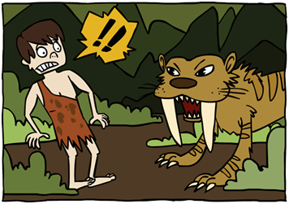
Adapting to the pandemic
Produced workshops flexibly to match the on-going changes:
Managing wellbeing during Lockdown
Resilience and wellbeing post-lockdown
Sleep well
Managing wellbeing for the shielding population
Employment status: Managing wellbeing
Began running a wellbeing support line
Notes:
We became aware of the different changes and we were quite flexible in our approach by producing different workshops to meet the changing needs of the population.
At first people were worried about the lockdown and so we made a workshop about that, then people began to worry about post lockdown and how they were going to adapt so we made a workshop for that.
We then noticed that the population were suffering from insomnia (from one third to a half of the population of England suffering from insomnia) – so we created a sleep well workshop. We then created a workshop for people who were shielding because shielding was being lifted. Employment status as we noticed that a lot of people were worried about employment especially with people being furloughed and being made redundant and letting people go.
Began running a wellbeing support line – this was developed as a response to the current pandemic. It is focused on people who are suffering with the different changes from the pandemic - when they call the support line we first go through a questionnaire with them which talks about how they have been impacted by the pandemic and based on that we offer them workshops (managing wellbeing lockdown) however if we noticed that they were struggling with something else like maybe assertiveness or stress we would try and add elements of that to the workshop so that they tailored workshops.
Follow up session 2 weeks after just to see how they are dealing and see how they found the training packs and to see if any of the skills or techniques that were discussed helpful

Slide 6
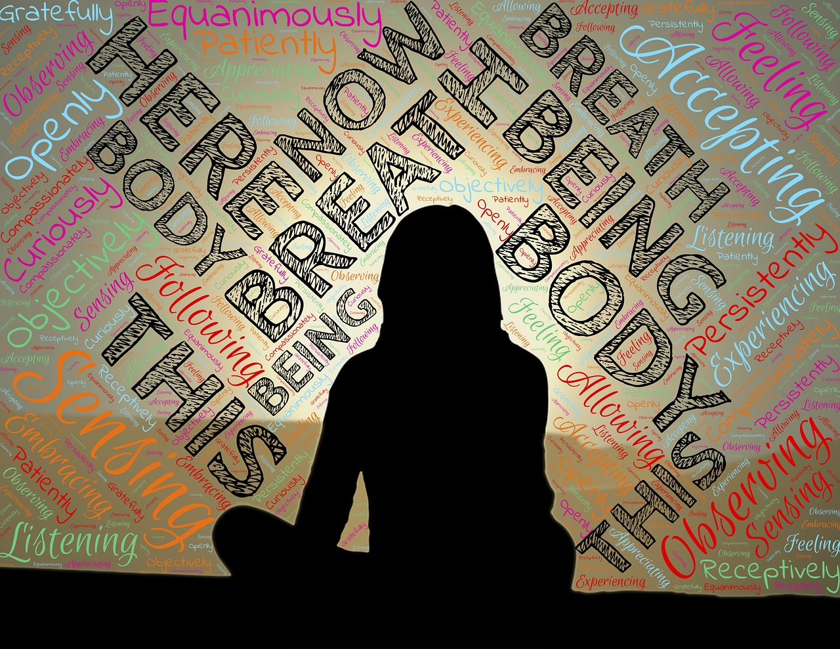
Mindfulness Practice
Notes:
Mindfulness Script:
Let's begin by taking a moment to allow your body to settle (2 seconds).
Find a comfortable position that allows your spine to be long but with a natural curve in the low back (2 seconds).
You can close your eyes (2 seconds) or keep them open with a soft gaze downward a few feet in front of you.
Let the belly and shoulders relax (2 seconds).
Today I’ll guide you through a focused attention practice focusing on the breath, this will help calm your mind and relax your body (2 seconds).
Before we start take a full breath in (2 seconds) and a long breath out (5 seconds).
Now allow the breath to find its natural rhythm in and out (10 seconds).
Begin this practice by connecting with what draws you here (2 seconds).
Maybe it's a wish for greater well-being for yourself and for others.
Maybe a desire for some rest and calm (15 seconds).
Now bring your attention to the breath (2 seconds).
You may notice movement of the abdomen or chest (2 seconds),
sensations of air passing at the tip of the nose (2 seconds),
sensations in the throat (2 seconds),
or a sense of the whole body breathing (5 seconds).
Wherever the sensation is most vivid for you,
allow your attention to rest there (15 seconds).
Breathe in, breathe out (5 seconds).
Can you notice the moment the inhale begins?
How it continues and the moment it ends? (5 seconds)
Can you notice the very moment when the exhale begins? (10 seconds)
How it continues and the moment it ends? (5 seconds)
Is there a slight pause before the next inhale begins? (10 seconds)
Try to keep your attention focused through one complete cycle of breath (20 seconds).
See if you can sustain your focused attention on the breath for another breath (2 seconds),
then another complete cycle of breath (30 seconds).
When you notice the mind has wandered,
just come back to this awareness of the breath (2 seconds)
with gentleness, kindness, and without judgement (30 seconds).
Allow the breath to be a kind of home base (2 seconds),
an anchor for awareness (20 seconds).
Thoughts will come (2 seconds) and thoughts will go (2 seconds).
No need to push them away (2 seconds) or to chase after them.
When the mind wanders, just come back to the breath,
come back to this moment (2 seconds),
right here, right now (30 seconds).
Lets finish this focused attention practice now by taking a full breath in (2 seconds)
and a long breath out (5 seconds)

