Slide 1
Patient Experience
St Georges University Hospital
Healthwatch Assembly
Sept 2017
Sarah Duncan – Patient Experience Manager
Helen McHugh – Divisional Director of Nursing and Governance

Slide 2
Outline…
Who we are and what we do
What to expect in hospital
Keeping you safe/well
How we monitor patient experience
How we monitor standards of care
How to raise concerns
How to get involved

Slide 3
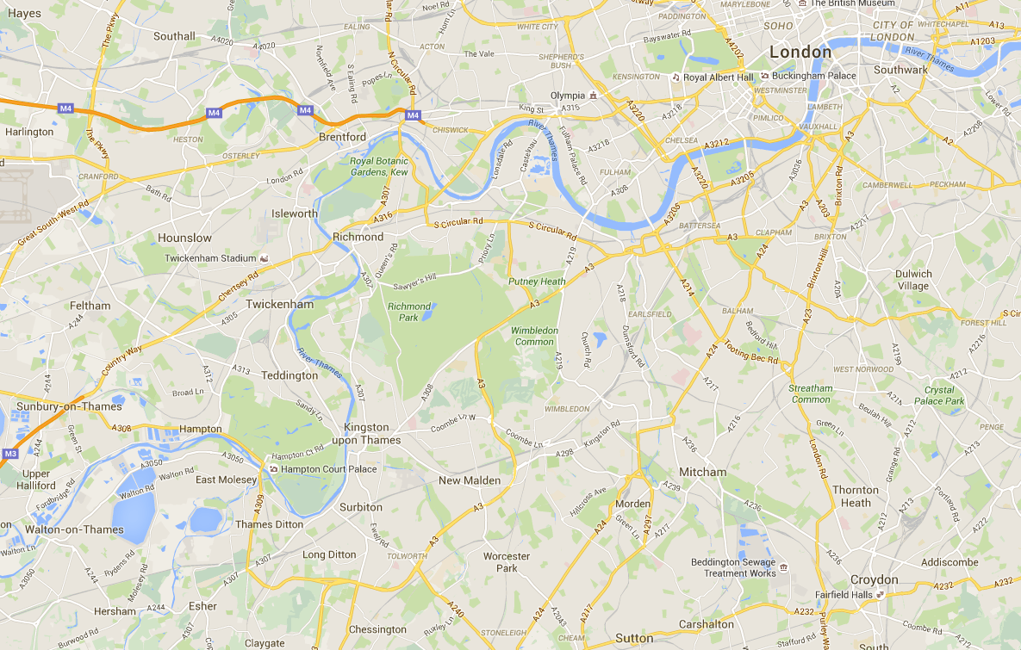
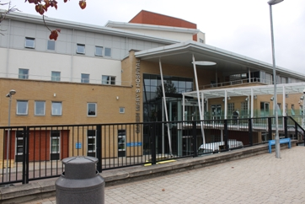
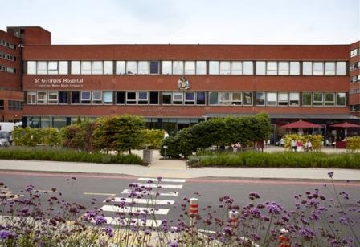
St George’s cares for a population of 1.3 million across south west London. Two main hospitals, plus a range of community settings.
Queen Mary’s Hospital
St George’s Hospital
We share our Tooting campus with
St George’s, University of London.
As well as our two main hospitals, we provide care in health centres, GP surgeries, schools, people’s homes and HMP Wandsworth.

Slide 4
We are a teaching hospital, a tertiary referral centre, and a community provider. We touch the lives of thousands of people.
648,000 outpatients treated each year
9,500 staff
5,156 babies delivered per year
21,500
Foundation Trust members
28,500 elective procedures every year
330 volunteers
Emergency Department sees 400 patients each day
We provide services from 12 health centres

Slide 5

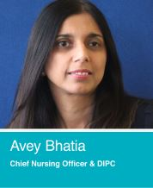
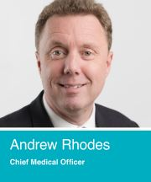
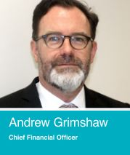
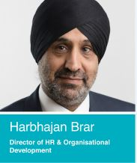
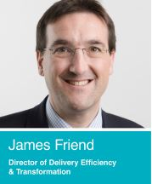
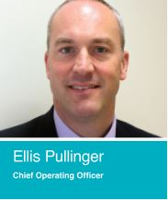

Our Executive Team

Slide 6
What to expect in hospital…
What to bring:
  Medication
  Recent discharge/GP letters
  Night clothes and wash kit
  Clothes for discharge
Ward Round and patient involvement
Multiprofessionals on the ward
Same Sex Accommodation
Food choices and special Diets

Slide 7
Hospital etiquette…
Things to remember while you are in hospital:
Tell staff if you're going out of the ward or unit.
Listen carefully to information about your treatment and medication.
Ask staff to explain something to you again if you don't understand.
Tell the doctor about any treatments you're already receiving or any allergies you have.
Don't take any medication you have brought with you from home.
Treat staff, fellow patients and visitors politely and with respect. Verbal abuse, harassment and physical violence are unacceptable and may lead to prosecution.
Follow the rules for your ward.

Slide 8
Keeping Safe/well…

Slide 9
Keeping Safe/well…

Slide 10
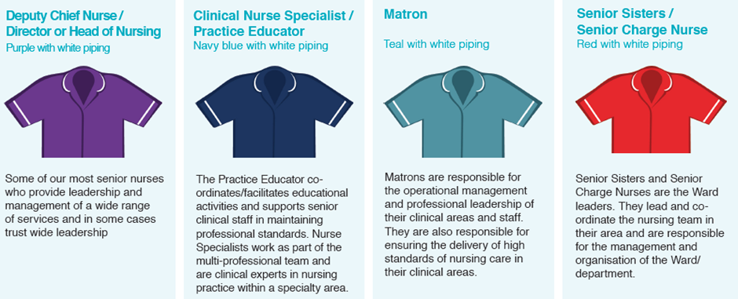
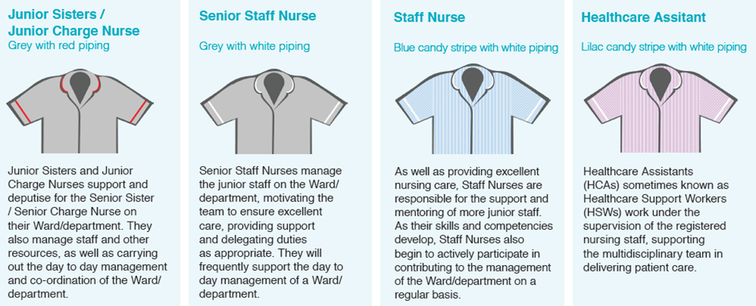
Who is who…

Slide 11
How we monitor patient experience…
National Patient Surveys
Friends and Family Test
Discharge Survey
Complaints and PALS contacts

Slide 12
How we monitor standards of care…
Incident data
Complaints and PALS
Compliments
Healthwatch/External visits
Internal mock/quality inspections
Monthly quality audits
Patient Choices
Safe Staffing

Slide 13
Incidents and Duty of Candour…
What happens following an incident
Will I or my relative be informed
How is it investigated
What learning takes place and is shared

Slide 14
How to raise concerns…
Don’t take your troubles home
Ward Sister/Charge Nurse
Matron and Heads of Nursing
PALS
Complaints

Slide 15
How to be involved…
Volunteer service
Patient representatives
  User groups
  Internal Inspections
  Committee Representation
Healthwatch Governor

Slide 16
Questions

