Slide 1
Introduction to Health Inequalities in Wandsworth
Mary Idowu – Deputy Director for Wandsworth Place Partnership
13th October 2022

Slide 2
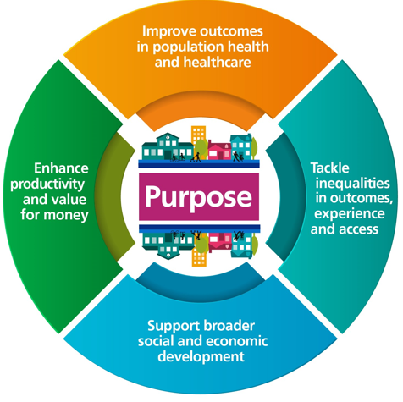
What are Integrated Care Systems?
Integrated Care Systems are partnerships of organisations that come together to plan and deliver joined up health and care services to improve the lives of people in their area. They will be responsible for how health and care is planned, paid for and delivered.
ICSs have four key purposes:
improving outcomes in population health and healthcare
tackling inequalities in outcomes, experience and access
enhancing productivity and value for money
supporting broader social and economic development
Notes:
https://www.who.int/health-topics/social-determinants-of-health#tab=tab_1

Slide 3
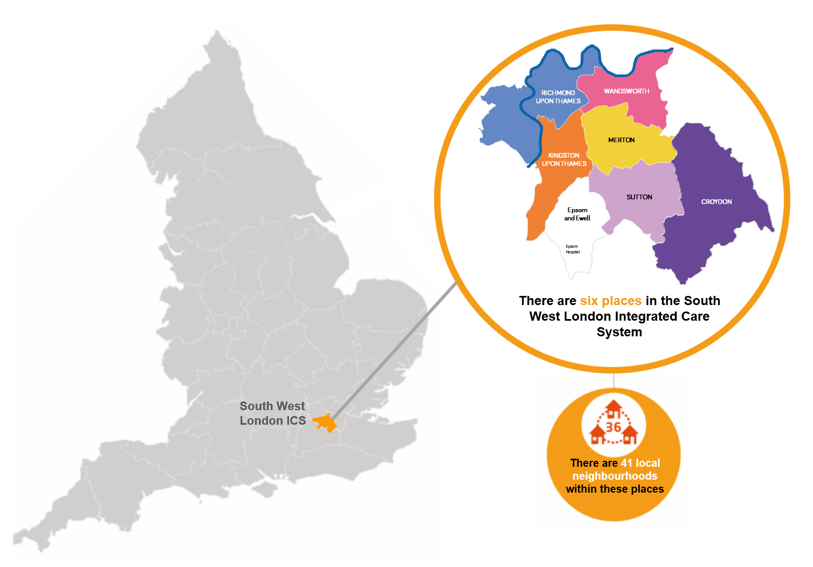
SW London Integrated Care System
South West London Health and Care Partnership was granted Integrated Care System status in 2020, and on 1 July 2022 we will take on statutory responsibilities.
We bring together NHS organisations, local councils, Healthwatch, charities, community and voluntary organisations to improve local health and care services and to improve the health and wellbeing of local people.
Our ICS is made up of six ‘places’ – Croydon, Kingston, Merton, Richmond, Sutton and Wandsworth.
Since we were set up in 2018, we have developed better and more convenient services, invested in keeping people healthy and out of hospital and set shared priorities for the future through our local health and care plans for each borough.
Notes:
https://www.who.int/health-topics/social-determinants-of-health#tab=tab_1

Slide 4
Wandsworth Place Partnership
Partners:
Battersea Healthcare CIC (GP Federation)
Central London Community Healthcare NHS Trust
Healthwatch Wandsworth
South West London and St George’s Mental Health NHS Trust
South West London Integrated Care System
St George’s University Hospitals NHS Foundation Trust
Wandsworth Borough Council
Wandsworth Care Alliance

Slide 5
What are health inequalities?
Health inequalities are unfair and avoidable differences in health across the population, and between different groups within society.
Access to health care
Experiences of health care
Outcomes in health care
Risk of health conditions
Life expectancy – how long you life
Impacts health and wellbeing

Slide 6
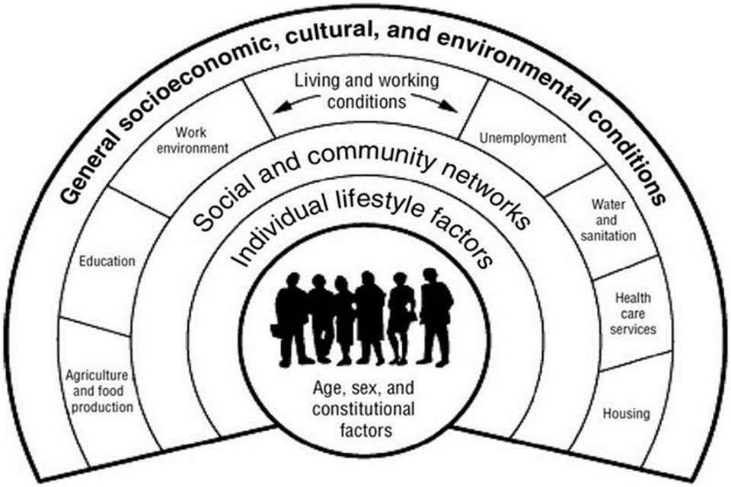
What factors influence your health?
The broad social and economic circumstances can influence health
Notes:
https://www.who.int/health-topics/social-determinants-of-health#tab=tab_1

Slide 7
Impact of health inequalities
Health inequalities is complex
We want a fair and equitable society, so people in Wandsworth can live a healthy lifestyle
We want to prevent health conditions and deaths where it is avoidable
Some sobering examples of health inequalities
Healthy life expectancy increases with average income.
The relationship between employment and health is stronger for healthy life expectancy than life expectancy.
In England, 62% of adults are overweight or obese and only 36% of adults walk or cycle five times per week, on average.
Black women still four times more likely to die in pregnancy and childbirth
28% of private renters in non-decent homes rate their health as less than good, compared with 22% living in decent homes.
People who identify as LGBTQ+ have higher rates of common mental health problems and lower wellbeing than heterosexual people
People with learning disabilities were at higher risk of death due to Covid compared to the general population
People experiencing homelessness face significant barriers to accessing health and social care compared with the general population
Notes:
https://www.centreformentalhealth.org.uk/publications/mental-health-inequalities-factsheet
https://www.health.org.uk/evidence-hub/money-and-resources/income/relationship-between-income-and-healthy-life-expectancy-by-neighbourhood

Slide 8
How are we tackling this?
We can’t do this alone! We’re working with partners as an integrated care system e.g. councils, NHS Trusts, voluntary sector, patient representatives (and more)
NHS Core20PLUS5
Core20 - Focus on people in most deprived areas parts of England (20% most deprived)
PLUS – Other groups impacted by health inequalities e.g. homeless, travellers,
5 – Focus on areas Maternity, Severe mental illness, Chronic respiratory disease, Early cancer diagnosis, Hypertension
Wandsworth Health and Care Plan
Data – working with analysts to understand where there are inequalities in localities
Primary care networks (PCNs) - Tackling neighbourhood inequalities
Prevention – healthy lifestyle (diet, physical activity, wellbeing), early diagnosis so that we can prevent illnesses or treat earlier and prevent severe conditions
‘Strategic engagement’ – Thinking Partners Forum is a forum with membership across the VSCE and patient groups with the aim of bringing together our community to share insights, good practice and network with the overall objectives of system influence.
Engagement - e.g. health champions, connectors

Slide 9
Sample 4
In partnership with
Core20 (76k population)
WANDSWORTH
Remaining80 (335k population)
Age
64|68
Healthy Life Expectancy
82|84
Life Expectancy
Ethnicity
14%|11%
Asian
22%|8%
Black
12%|10%
Other
52%|71%
White
2 in 10 are in C20
4 in 10 are in C20
2 in 10 are in C20
1.5 in 10 are in C20
18% of Wandsworth residents are in Core20
Areas include Latchmere and Queenstown
Borough
In contrast, only 4% of residents in Richmond and 2% in Kingston are in Core20
Long-Term Conditions
26% have a Long-term Condition
23% have a Long-term Condition
Notes:
source ONS Health State Life Expectancy, 2017-2019,

Slide 10
Thank you.
For any other information or enquiries contact: mary.idowu@swlondon.nhs.uk

