Slide 1




Welcome
We are the Wandsworth independent champion for local people to share their views on publicly funded health and social care
We promote and support involvement of the public in health and social care
We will record this meeting – please turn off your camera if you don’t want to appear
Mute during presentations
Remember to unmute when its question time
Any questions can put them in the chat box
Presentations will be available after the event

Slide 2

Todays event:
Health Inequalities in Wandworth

Slide 3
Together we will:
Monitor progress by local NHS and public health services to tackle health inequalities.

Slide 4
Health inequalities
What are health inequalities?
Health inequalities are known as unfair and avoidable differences in the health of people across social and population groups.
It can affect people’s health and their access to health and social care.
Why talk about this?
The Marmot review in 2010 was clear that the NHS and local councils can help tackle them. The review already highlighted the impact of inequalities on people’s health – and Covid has brought the issue to the fore.

Slide 5
Agenda
1:00 | Introduction – What do health inequalities look like in Wandsworth? – Stephen Hickey – Healthwatch Wandsworth Chair
1:10 | How NHS Wandsworth has been working to tackle health inequalities - Mike Proctor, Director of Transformation & Naomi Good, Engagement Manager, NHS Wandsworth.
1:30 | How Wandsworth Council has been working to tackle health inequalities
1:40 | 5 min comfort break
1:45 | Introduction to breakout topics
1:50 | 4 break-out topics Digital appointments, community communications and conversations, mental health wellbeing and Managing and Long-Term Conditions
3:10 | Closing feedback
3:20-25 | Close

Slide 6
Reminder:
We will record this meeting – please turn off your camera if you don’t want to appear
Mute during presentations
Remember to unmute when it is question time
Any questions can be put in the chat box
Presentations will be available after the event

Slide 7

What do health inequalities look like in Wandsworth?
More details available in:
Wandsworth Director of Public Health Annual Report: https://www.datawand.info/director-of-public-health-annual-report/
Wandsworth Health and Care Plan 2019-2021: https://www.wandsworth.gov.uk/media/5565/wandsworth_health_care_plan_welcome.pdf

Slide 8






Factors & causes of health inequalities
  The many factors and causes include:
    Physical health status: e.g. life expectancy and health conditions
    Access to care: e.g. availability of treatments
    Psycho-social factors : e.g. isolation and social networks
    Health behaviours: e.g. smoking and alcohol
    Other determinants of health: e.g. quality of housing, work, surroundings, money and resources, education and skills.
  They are all inter-related and fit together to contribute
  to our level of health and wellbeing.
  Today we will be focusing on health and support for
  wellbeing.
Notes:
There are differences between population groups/combinations of these factors – not random/by chance and are largely socially determined – they are not inevitable.
The factors and causes interrelate and contribute to the overall health inequality faced by a vulnerable person.

Slide 9
Who experiences health inequalities?
Health inequalities can be considered across a range of dimensions, including: Socio-economic deprivation, gender, ethnic group, sexual orientation, employment Status, disability and access to green spaces
A significant proportion of people in Wandsworth are at risk of health inequalities, e.g.:
  Nearly 1/3 of the borough belongs to a BAME group.
  Over 20% of the population in relative poverty.
  Over 17% of the pupil population in Wandsworth are recording as having a Special Education Need or Disability (SEND).

Slide 10
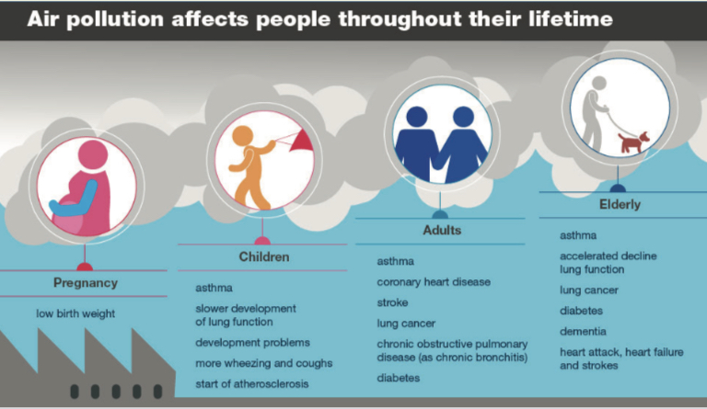
Air Pollution
Poor air quality affects everyone, it has a disproportionate impact on the young and old, the sick and the poor.
Labourers are likely to be exposed to more harmful gases, particularly if they work at the roadside, building sites or factories.
People in areas of deprivation are also more likely to be exposed to higher concentrations of air pollution and are more likely to have pre-existing medical conditions.
Image taken from Public Health England Website: Health matters: air pollution published 14.11.2018

Slide 11

Cardio Vascular Disease (CVD) & Diabetes
3,422 had a history of stroke or transient ischemic attack (TIA) (Wandsworth 2018/19).
14,460 people aged 17 or older had been diagnosed with diabetes (Wandsworth 2017/18).
Diabetes is the leading cause of premature death in Wandsworth and it is responsible for a range of complications including CVD, blindness, kidney failure, nerve damage and foot disease.
For CVD, diabetes and many other health conditions there
is an interplay between the condition and level of diet
and exercise, in turn impacting on health and wellbeing.

Slide 12





Diet and Exercise
Poor diet and insufficient exercise contribute to poor health – e.g. obesity, diabetes, and other conditions (including low self-esteem and mental stress).
Groups that experience health inequality are less likely to maintain good diet and exercise routines. In practice financial and other factors mean that some groups are much more affected than others. They include disabled groups, certain ethnic minorities (especially Asian and Black adults) and people suffering in poverty.
1 in 3 primary school children are obese or overweight and more than half of over 16 year olds are overweight or obese.

Slide 13
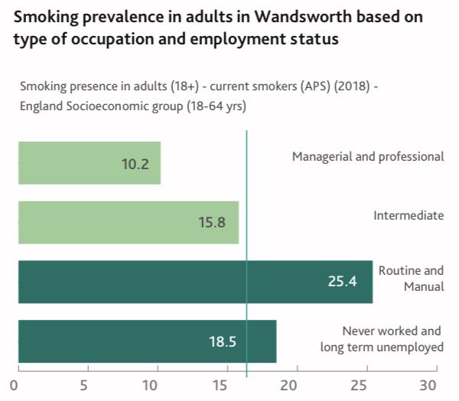
Smoking
Smoking prevalence is higher in certain population groups = greater risk of health complications and poorer outcomes.
For example, those in lower paid occupations and the long term unemployed are twice as likely to smoke compared to the highest earners in Wandsworth.
Image taken from Wandsworth Director of Public Health Annual report 2020

Slide 14
Alcohol & Substance Abuse
About 44% of adults in Wandsworth drink more than the safe limits of alcohol per week, the highest rate in London.
Wandsworth has the most alcohol-related conditions compared to the rest of the nation.
Risk factors (homelessness, unemployment/poor working conditions, mental health issues) for alcohol and substance abuse are prevalent in the borough.

Slide 15

Isolation and Mental Health
Social exclusion and isolation affect many people living in Wandsworth and can lead to poor mental health and/or mental wellbeing.
Our mental health and wellbeing is influenced by our individual characteristics such as our age, personality, gender or genetics as well as our experiences.
Our surroundings and the environment in which we live are also factors.
In Wandsworth, 44,000 adults have a common mental health disorder.

Slide 16
What have people told us recently?
Some people are more reliant on others to support them with telephone or online appointments, e.g.
Interviewee with learning difficulties felt that without support of their family she wouldn't be able to access the medications, which in turn would put her health and life at risk.
Interviewee with learning difficulties found no flexibility with the day and time of appointments. He has support hours and has to organise arrangements with his support worker.
  Interviewee with mental health condition felt she was not able to connect very well over the phone and could not see a person she was speaking with. This made her feel not being in charge of the situation.
Notes:
Just a few samples of some themes around health inequalities that have been shared with us recently (since COVID-19)

Slide 17
What have people told us recently?
Interviewee with mental health condition has no internet access (used to rely on access from work) - has no problem with using the internet except that cannot afford it.
Others reported easier access
“My daughter has autism and finds going to the surgery very stressful. The phone call appointment removed that barrier.”
Family carers have felt isolated and with fewer resources
“Left me exhausted and mentally drained caring for a severe learning disability child without help for over 6 weeks although I wasn't well myself.”
Interviewee with learning difficulties found it difficult to communicate with the receptionist as his disability wasn’t taken into consideration. They spoke fast and made him feel uncomfortable.
Notes:
A few themes around health inequalities that have been shared with us recently (since COVID-19)

Slide 18
How NHS Wandsworth has been working to tackle health inequalities
Mike Proctor, Director of Transformation & Naomi Good, Engagement Manager, NHS Wandsworth.
Notes:
– 15 mins + 5 mins Q&A
Say something about us never having enough time for everything – that people can feed back on these topics and more, via the chat box.

Slide 19

Notes:
Unable to attend today but the Public Health Team want us to feed back your questions, they will be listening.
4 min video provided for 10 min slot: https://www.youtube.com/watch?v=iiKenDbHufA&feature=youtu.be

Slide 20
Taster & discussion sessions
We will arrange for everyone to be in a group to discuss each of the 4 topics.
To make this as easy as possible for us and you to manage, we will put people into ‘virtual rooms in groups’.
The presenters/facilitators for each topic will spend a 15 minute session with each group.
After each session the presenter/facilitator will change group.
If you want to take a break, put yourself on mute/turn off your camera and look out for when the next presenter arrives for the next session.

Slide 21
Digital appointments
Sarah Cook, HWW Manager & Naomi Good – NHS Wandsworth PPI Manager
Community communications and conversations
Gijs Van Amelsvoort, WCA/HWW Communications Officer & Delia Fitsimmons, HWW Engagement and Outreach Lead
Mental health wellbeing
Noel Brown, Melissa Mehmet, Susan Akinnaike, Folashade Ojo, Talk Wandsworth Wellbeing Team
Managing and staying well with a Long-Term Condition
Thomas Herweijer, Project Manager – Long Term Conditions , NHS South West London CCG & Dominic Mehlig HWW Volunteer)
Please click - join breakout group session
Notes:
We value your experiences and knowledge

Slide 22
Closing feedback
Notes:
TBD

