Slide 1
Waltham Forest Dialogue Meeting
3rd September 2015
Presented by Roan Dyson, Riaz Khan and David Beer
Independent Health Complaints Advocacy Services
Notes:
1

Slide 2
The History
Since 2005 made a statutory service under Health and Social Care Act funded by Department of Health and called ICAS (Shipman)
National Service with 3 main providers
London and other regions provided by POhWER until 2013 (Mid Staffs)
2013 funding devolved to Local Authorities and recommissioned
Various different advocacy providers won contracts
2013 to 2017 Pan London contract covered 26 Boroughs
2017 POhWER won Pan London with 22 Boroughs and Islington and City coming to POhWER under separate contracts
Model for Pan London :
2 managers
14 fte advocates across 2 teams East and West
Helpline
Home based with community meetings

Slide 3
POhWER IHCA in 22 London Boroughs
Barking & Dagenham | Brent
Bromley | Barnet
Camden | Ealing
Enfield | Hammersmith and Fulham
Greenwich | Hillingdon
Haringey | Wandsworth
Islington | Kensington and Chelsea
Redbridge | Kingston Upon Thames
Lambeth | Merton
Southwark | Tower Hamlets
Westminster | City of London

Slide 4
Independent Health Complaints Advocacy
POhWER Independent Health Complaints advocates can support a person to navigate their way through the NHS Complaints process by providing;
Helpline: front line support SHIP , website, signposting
Remote: Support to pursue the complaint themselves providing phone support with letters, emails and exploring options and outcomes available.
Face to face meetings for those clients whom require one to one advocacy support to conduct their complaint.

Slide 5
Independent Health Complaints Advocacy
Free
Confidential
Independent from NHS
Primary and acute NHS funded services including acute and community NHS Trusts, NHS England, Clinical Commissioning Groups, GPs, pharmacies, opticians and dentists
For everyone including children and people in secure services such as prison
Commissioned by Local Authorities
Working in partnership with Healthwatch, CQC, PHS Ombudsman, other voluntary sector providers and advocacy services
Translation and interpreting and Easy Read available

Slide 6
IHCAS
Listen to the persons experience and complaint issues
Talk about what support is needed to raise the complaint/s
and help focus people on the issue
Provide information;
explain complaints process,
explore and discuss options and outcomes at all stages
navigate NHS services
consult NHS regulations, NICE guidelines, other available
guidance e.g. Safeguarding Policy, Human Rights Act, DPA, FOI,
Duty of Candour
Manage expectations and boundaries
Help write effective letters to the right people and understand
responses
Prepare for and attend meetings
PHSOmbudsman applications and process
Consider whether you are satisfied with the response you receive
and review
Signpost to other organisations where appropriate

Slide 7
How advocacy works

Slide 8
What we can do
We will listen to the complaint
We will ask clients how they would like to be helped
We will find out how best to communicate with our client
We will give information about the NHS complaints process
We will explain options
We will explain possible outcomes
Ensure people are safe through safeguarding procedures
Empowerment model – just enough support to enable people to take as much control as possible
POhWER Promises: respond within 2 days, Client Advocacy Plan
Use of interpreters
How we can support
Writing complaint letters
Attending meetings
Parliamentary and Health Service Ombudsman application

Slide 9
What we can not do
Investigate complaints
Give clinical advice
Give legal advice
Counselling
Befriending
Secretarial service

Slide 10
Outcomes and expectations
Most people want and can achieve
An investigation
An explanation as to what has happened
An apology where due
Correction of policy or procedure where required
Reassurance same thing will not happen to them or someone else gain
Sometimes
Correction of treatment where possible
Financial redress to put a person in place would be had event not happened
Improved services
Not realistic
NHS staff sacked –signposted to GMC, NMC, other professional bodies
Compensation or changes to medical records – signposted to legal service and ICO
Changes in treatment
Complaints spanning over 12months ago unless exceptional circumstances

Slide 11
Feedback
Most people say they:
Want to be listened to
Taken seriously
Support with ‘the system’
An outcome
Reassurance they will not have same thing happen again
Be safe
‘My advocate gave me the confidence to speak up for myself in the meeting’
‘My advocate gave me the strength to get closure and move on’
We use outcome star and encourage people to a place to self advocate.
We deal with complaints swiftly and learn.

Slide 12
People need to know about our service and what it offers:
We reach out to people who otherwise will find it hardest to get to know about the service
We are locally engaged as well as bringing the learning and best practice from working nationally.
We share outcomes/issues and trends to inform and lever improvements above and beyond the individuals who use our service by liaising with:
Commissioners
Healthwatch
CQC where investigations imminent or serious issues
PHSO and NHSEngland
Promotion
NHS providers (hospitals/GPs and other primary care and community services/ mental heath Trusts)
Healthwatch,Voluntary organisations and Community groups
Carers networks
Social services
Others… MPs, other care providers, advocacy services and charitees

Slide 13
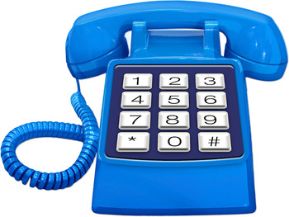
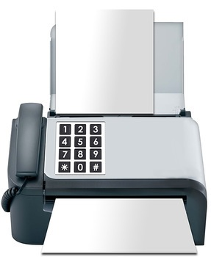
Contact us
POhWER, PO Box 14043, Birmingham, B6 9BL
0203 553 5960
0300 456 2365
pohwer@pohwer.net
www.pohwer.net
Opening hours: 8.00am to 6.00pm Monday to Friday

Slide 14
Other Advocacy services: Voiceability

Slide 15
Voiceability
f you need to contact your local service you can use the map to find their details.
IMCA Referrals
Tel: 0300 330 5499
Fax: 0208 330 6622
Email us
Care and Support Referrals
Tel: 0300 222 5948
Text: 07860 022939
Email us

Slide 16
Any questions?

